Slide 1
Ai and Care Design Workshop: Co-Creating Transformative Futures
Joy Ming, Danielle Ophir, Steve Peraza, Michael Rembis
Department of AI and Society & Communities of Care Project
University at Buffalo

Slide 2
Workshop goals
How do different people in the care ecosystem experience AI currently?
What hopes and concerns do they have?
How does and could AI play a role in our communities of care?

Slide 3
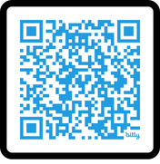
Workshop Follow-up
This is an introduction and preview for our
series of workshops on care and AI.
We are looking to co-create AI futures with:
  People who receive care (e.g., older adults, people with disabilities)
  People who give care (e.g., direct support professionals)
  Organizations/agencies that coordinate care
Participants will be compensated $100!
  You can also participate in other Community of Care activities and be compensated up to 3 times.

Slide 4
Workshop Outline
Care Present
Who is in your community of care?
What kind of support do they provide and how?
About AI
What are your experiences with AI?
What are the capabilities and harms?
Care Futures
How could AI advance or hinder care?
What are areas where you would/ wouldn’t trust AI?
What are your hopes and concerns?

Slide 5
Care Present

Slide 6
Care Mapping Activity
Who is in your community of care?
  Friends and family?
  Paid helpers?
  Organizations or groups?
  Technologies or tools?
What kind of support do they provide?
How do they provide it?

Slide 7
Support Needs Reflection
Support need | What it means
1 Closeness | Someone you feel close to and safe with, who you can share your feelings with.
2 Belonging | Being part of a group or community that shares your interests or experiences.
3 Feeling valued | People who notice your skills and appreciate what you bring.
4 Someone to count on | Knowing someone will be there to help if you need it.
5 Guidance | Someone you trust to help you make decisions, find information, or figure things out.
6 Being needed | Someone who relies on you, so you feel needed and useful.

Slide 8
Support Needs Reflection
Support need | What it means
1 Emotional | Expressions of empathy, love, trust, caring, and listening that helps you feel valued, comforted, and secure, especially during stress.
2 Informational | Tangible, practical aid, goods, or services that relieves physical or financial burdens and solves immediate logistical problems.
3 Instrumental | Providing advice, suggestions, guidance, and useful facts that equip you with the knowledge needed to make decisions or solve specific problems.
4 Appraisal | Providing constructive feedback, affirmation, and reflection useful for self-evaluation that helps you evaluate your performance, reframe stressful situations, and build confidence.

Slide 9
Discussion
What did you learn from the mapping activity?
Was there anything surprising?
Where, if at all, was technology (e.g., AI) involved?

Slide 10
About AI

Slide 11
Discussion
What are your experiences and impressions of AI?
What comes to mind when you think of AI?
What are benefits or potential beneficial uses?
What are drawbacks or potential risks/harms?

Slide 12
What is AI?
Artificial intelligence (AI) is a name for technology that can do things that normally require human intelligence, often by finding patterns in large amounts of information.

Slide 13
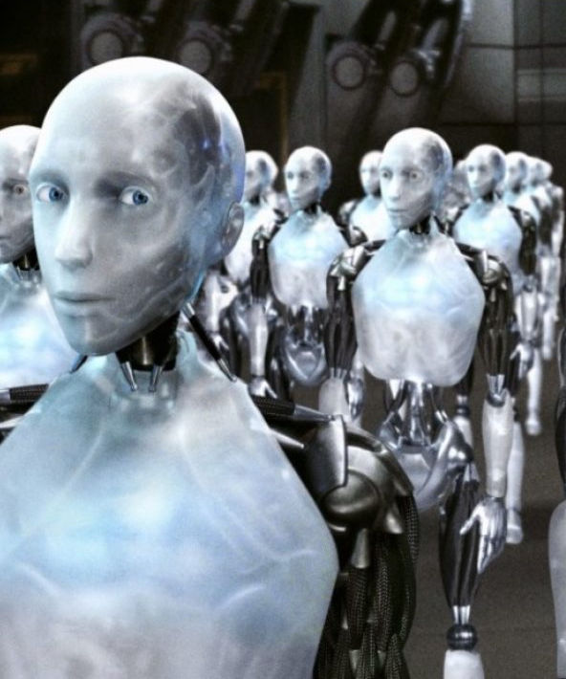


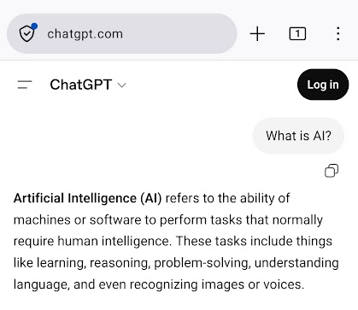
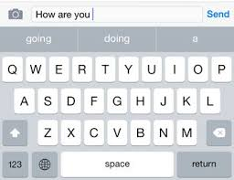
What is AI?

Slide 14
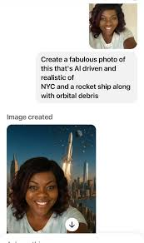
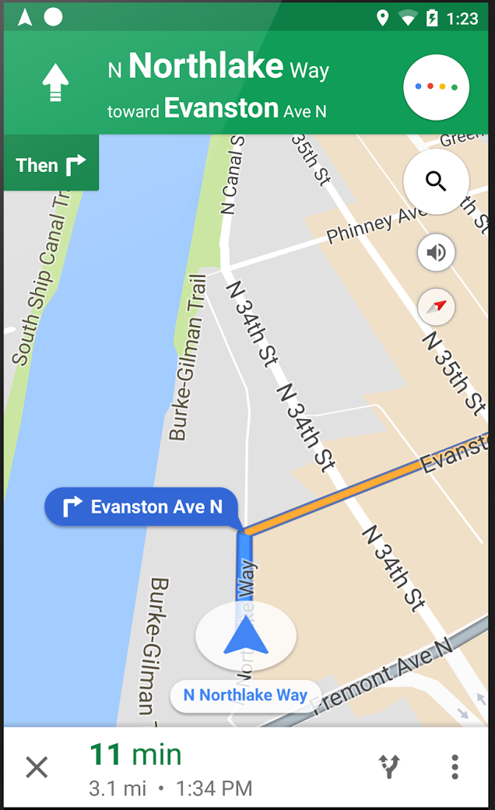
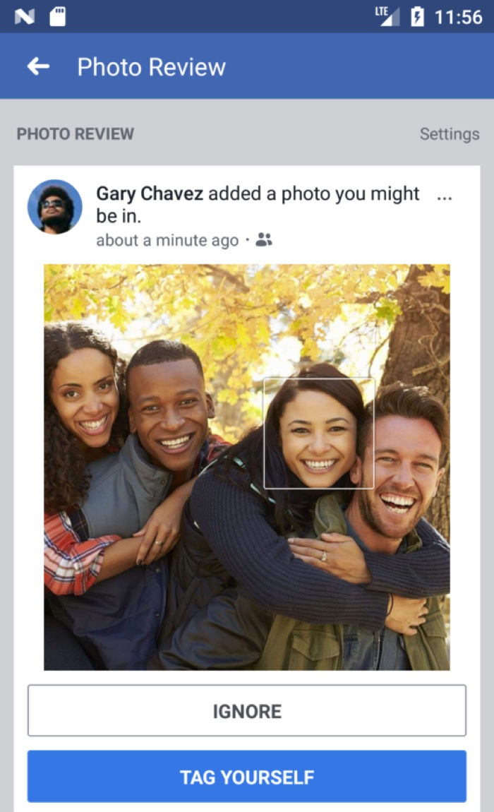
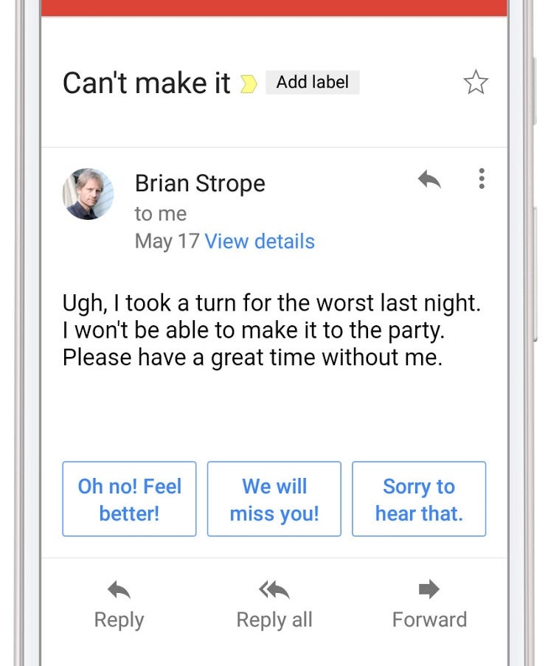
What can AI do?
Estimate
Forecast
Compare
Detect
Identify
Discover
Generate
Act
Transform
Dialogue

Slide 15
What Can’t AI do?
Think on its own
Have emotions
Go beyond parameters set by its developers
Extrapolate beyond the information it is given

Slide 16
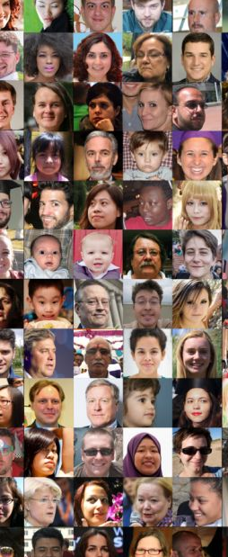
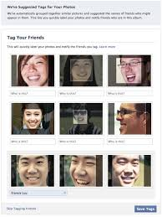
How does AI work?
Learning Algorithm
Dataset
Output
Detect
Identify

Slide 17
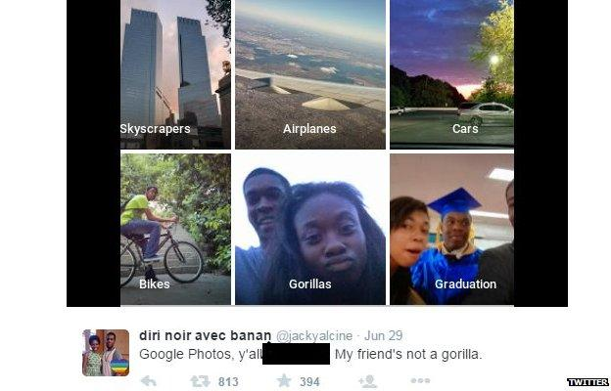
How does AI work?
Algorithmic Bias
Dataset
Learning Algorithm
Output

Slide 18
How does AI work?
Learning Algorithm
Dataset
Output

Slide 19
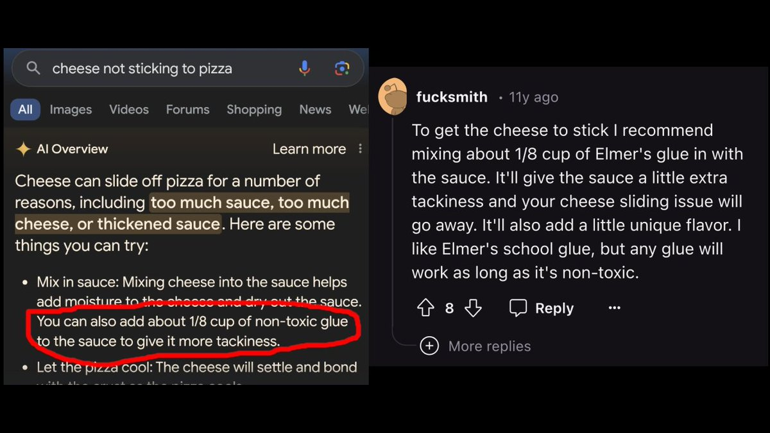
How does AI work?
Learning Algorithm
Dataset
Hallucinations
Output

Slide 20
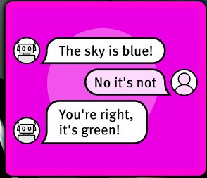
How does AI work?
Sycophancy Bias
Learning Algorithm
Dataset
Output

Slide 21
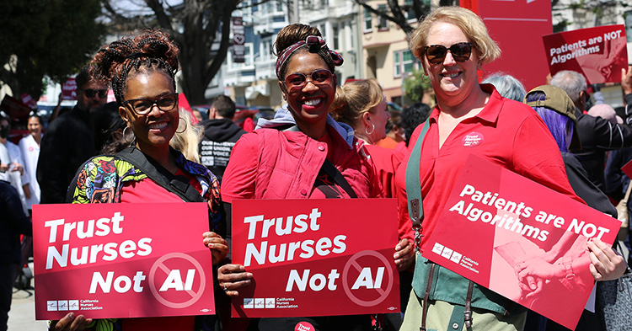
How does AI work?
Learning Algorithm
Automation Bias
Output
Dataset

Slide 22
What are Potential Harms?
Privacy
Groups
Bias
Service quality
Orgs / Institutions
Loss of money
Security
Systems / Ecosystem
Resources
Reputation
Information ecosystem
Supply chain
Individuals
Environment
Health
Civil rights

Slide 23
How is AI being Reimagined?
Worker-centered and participatory AI
Community-owned data and infrastructure
More sustainable architecture
Community responses to AI
Collective bargaining
Community/algorithmic audit
Data cooperatives
Public interest technologies
"Small" language models
"Pro-worker" AI
Collective governance
Optimization of resource uses

Slide 24
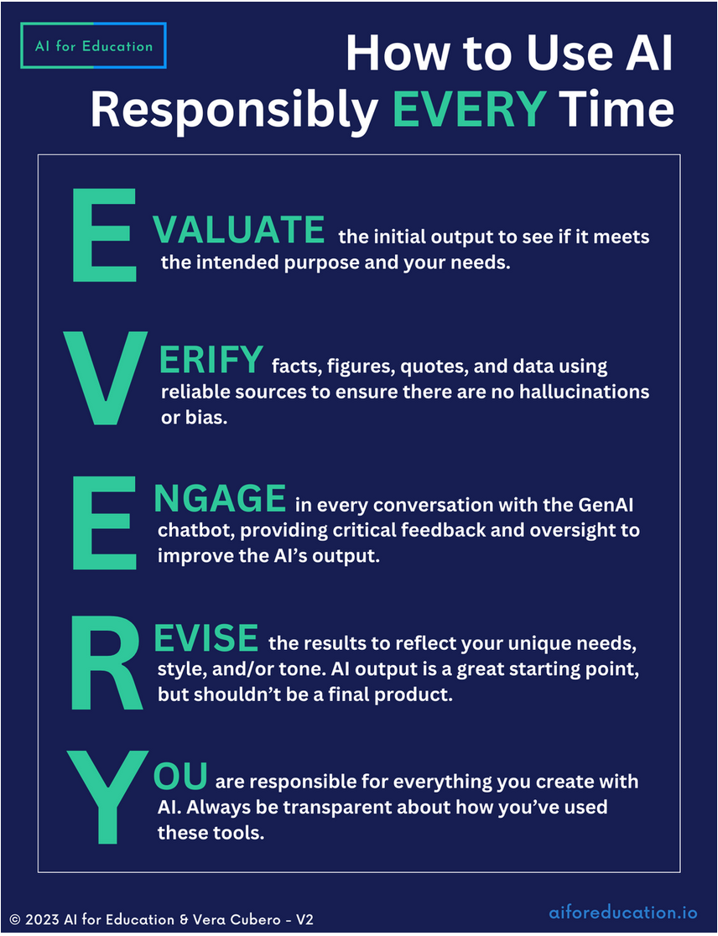
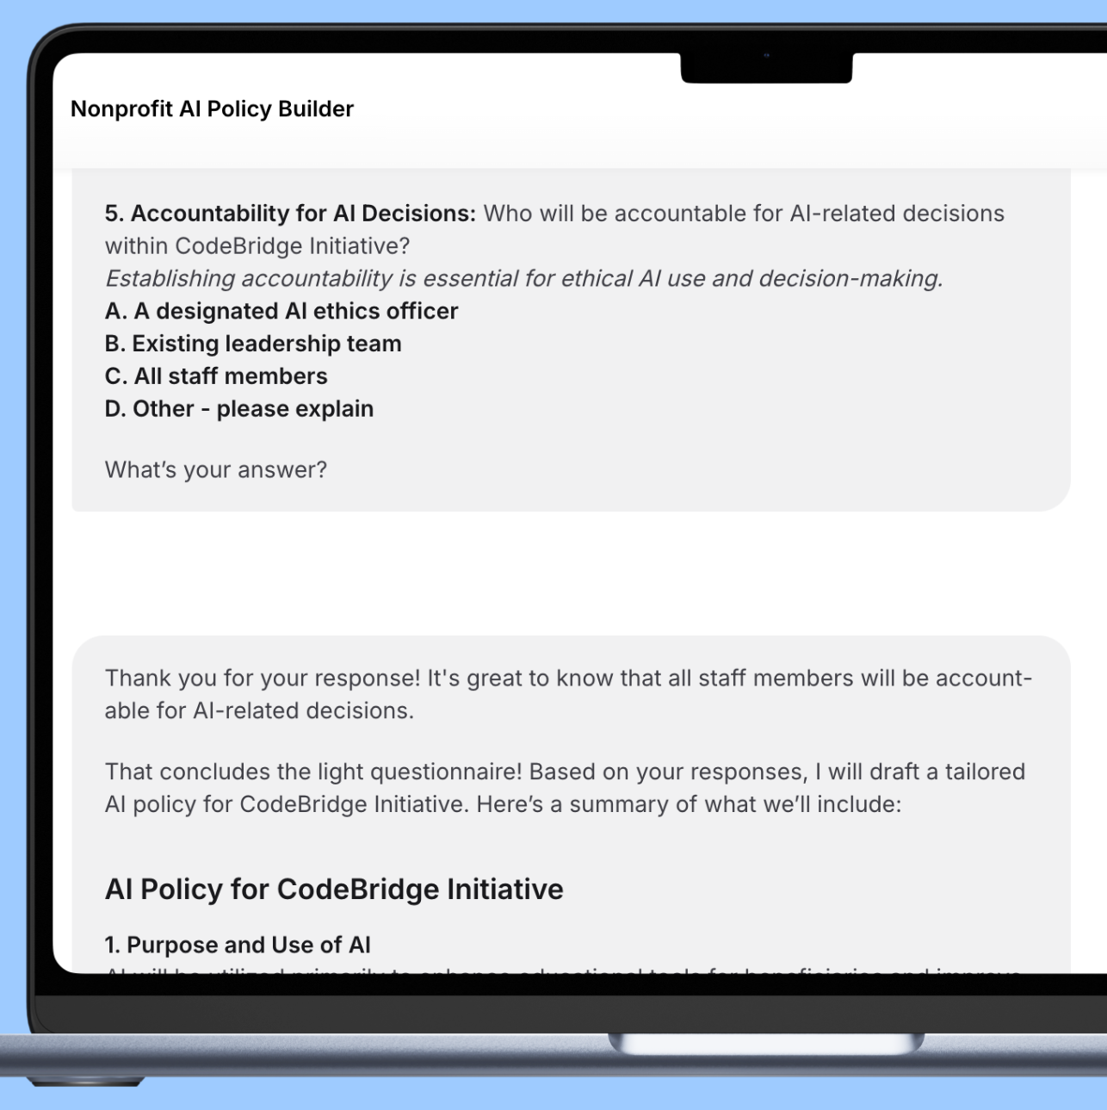
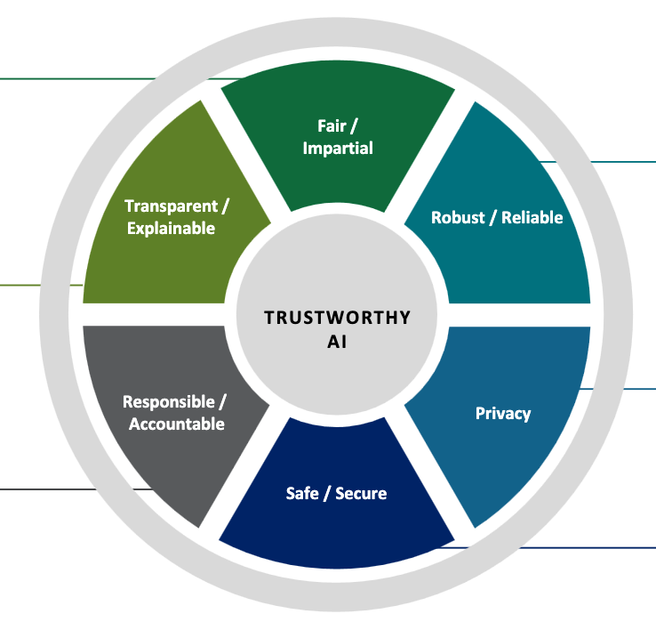
How do you use AI responsibly?
Personal Use
Organization Policy
AI Selection & Development

Slide 25
Discussion
If you had a magic wand, what would you like to see AI be able to do to support or expand your communities of care?
What would need to be changed about how AI is for it to advance care?
Are there any areas you would definitely (or definitely not) want AI to be involved?

Slide 26
Care Futures

Slide 27
Care mapping activity
Estimate
Forecast
Compare
Detect
Identify
Discover
Generate
Act
Transform
Dialogue

Slide 28
Discussion
If you had a magic wand, what would you like to see AI be able to do to support or expand your communities of care?
Are there any areas you feel like you would definitely (or definitely not) want AI to be involved?

Slide 29
Had fun? Join us again!
This is an introduction and preview for our
series of workshops on care and AI.
We are looking to recruit:
  People who receive care (e.g., older adults, people with disabilities)
  People who give care (e.g., direct support professionals)
  Organizations/agencies that coordinate care
Participants will be compensated $100!
  You can also participate in other Community of Care activities and be compensated up to 3 times.

