Slide 1

INTRODUCTION- NYAIL STAFF
Notes:
Introduction: Mick, Nancy, and Andria (NYAIL STAFF).
Lead into first slide regarding the “Olmstead Decision”. The Olmstead decision is vital to the work we do here at NYAIL as this decision opened the door for our participants to consider and obtain safe, accessible, and affordable housing.

Slide 2

Learning Objectives
• Understand the roles of the Transition Specialist (TS), Housing Specialist (HS), and Independent Living Specialist (ILS)
• Explore Person-Centered Transition Planning
• Identifying Barriers and Solutions
• Apply Motivational Interviewing
• Strengthen Interdisciplinary Collaboration
2
Notes:
This slide outlines what we’re hoping to accomplish during today’s training. The overall goal is to strengthen how we work together to support successful, person-centered transitions.
First, we’ll look at the different responsibilities of the TS, HS, and ILS. Each role has its own responsibilities, but understanding where those roles connect helps us work better as a team.
We’ll talk about what it means to keep the participant at the center of the transition process—making sure their needs, preferences, choices, and goals are guiding the plan.
We’ll also look at common barriers that can delay or impact a transition and discuss how we can work together to identify solutions.
We’ll introduce ways to use motivational interviewing to better engage participants, understand where they are in the process, and help them work toward their own goals.
Finally, we’ll focus on strengthening collaboration. Successful transitions require communication and coordination between the TS, HS, ILS, participant, and other members of the support team.
By the end of the training, the goal is for everyone to have a clearer understanding of their role, how our roles connect, and how stronger collaboration can lead to better outcomes for the participant.

Slide 3
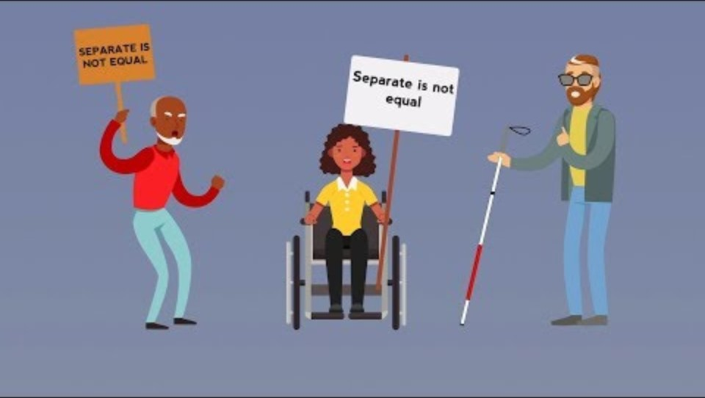
The Olmstead Decision Explained
Notes:
This video explains the Olmstead movement, which was enacted to provide civil rights for those with disabilities. Activist “demanded an end to segregation”, which lead to the Olmstead Decision in the US federal court system. The Olmstead decision is vital to the work we do here at NYAIL as this decision opened the door for our participants to consider and obtain housing and transition safely into the community.

Slide 4

• Promotes Independence and Dignity
• Improves Quality of Life
• Reduces Institutional Reliance
• Connects Individuals to Meaningful Community Supports
Why Community Reintegration Matters
3
Notes:
WHY COMMUNITY REINTEGRATION MATTERS: Community living ins more than a change in location
a. Promotes Independence-Individuals have greater control over where and how they live
b. Improves Quality of Life-Creates opportunities to pursue person al goals and live a life that reflects their individual preferences
c. Reduces Institutional Reliance- Working collaboratively with other community agencies increases the likelihood of a safe transition
d. Connects Individuals to Meaningful Community Supports- Which, once again, promotes independence, and increases connections within the community.; and annually saves states significant amount of money.

Slide 5
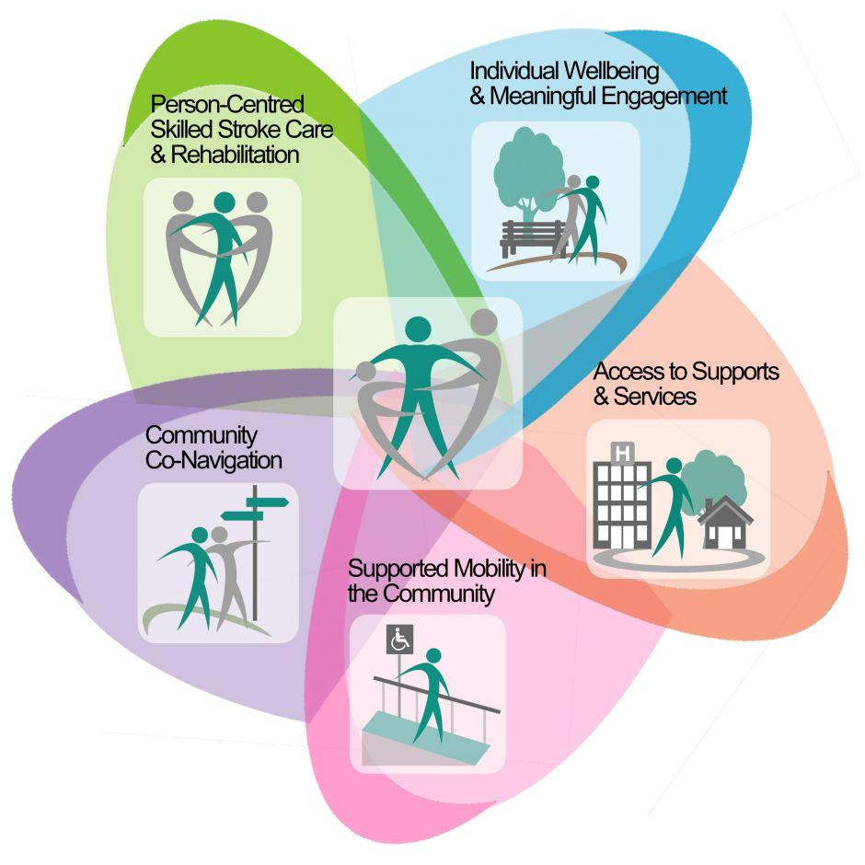
Re-Integrating into the Community
Creating Successful Community Person-Centered Transition Through Collaboration
1
Notes:
CREATING SUCCESSFUL COMMUNITY PERSON CENTERED TRANSITION THROUGH COLLABARATION
Person Centered Planning begins with
1. Identifying the participant’s goals, preferences, strengths and needs.
2. Specialist work to support informed choices, and encourage self determination
3. Develop a transition plan that reflects the person’s vision for community living
Cross system collaboration- includes:
1. HS/TS/ILS working with the NH staff (SW)
2. Nursing facility/and healthcare providers
3. Medicaid and disability services
4. LL and HS’s

Slide 6

Transition Journey
Referral → Housing Specialist → Independent Living Specialist → Community Resources → Community Integration
Everyone’s Role Makes a Difference!
4
Notes:
TRANSITION JOURNEY- EVERYONE’S ROLE MAKES A DIFFRENCE- a successful transition is not one person’s responsibility- it is a team effort centered on meeting the needs of the participant.
a. Housing Specialist- Work with the participant to identify safe, accessible, affordable housing, and maintain housing documentation throughout the length of the subsidy.
b. Independent Living Specialist – Creates a Person-Centered Individualized Service Plan (ISP) to build skills, confidence, and community connections

Slide 7
The Power of Collaboration
TS + HS + ILS = Successful Transitions Require Teamwork.
TS- Identifies Readiness and Prepares Participant for tasks ahead
HS- Secures: Safe, Affordable Housing and Housing Program Supports
ILS- Develops and Implements the Individualized Service Plan (ISP)
while Promoting Long-Term Community Stability
Collaboratively we can create a Safe Transitional Experience
by
Building Communication amongst the team
Sharing Documentation
Problem Solving Barriers
Utilizing Participant-Centered Decision-Making Skills which contributes to sustainable community living
9
Notes:
This slide really highlights how important teamwork is to a successful transition. The TS, HS, and ILS each have different responsibilities, but those responsibilities all connect.
The TS helps determine when the participant is ready to transition and prepares them for what needs to happen throughout the process.
The HS focuses on securing safe and affordable housing and making sure the necessary housing and program supports are in place.
The ILS focuses on the participant’s service needs by developing and implementing the ISP and helping the participant maintain stability once they are living in the community.
Even though we each have our own role, we can’t work in silos. Communication and sharing information and documentation helps everyone stay on the same page.
Barriers are going to come up during transitions. Working together allows us to identify those barriers early and figure out solutions as a team.
Most importantly, the participant should remain at the center of the process. We want to include them in decisions and make sure the transition supports their individual needs and goals.
A successful transition isn’t just about getting someone into housing. It’s about working together to create a safe transition that can lead to long-term stability in the community.

Slide 8

Transition Specialist (TS)
• Screen for Money follows Person (MFP) Eligibility
• Educate Individuals and Families on Community Living Options
• Provide Community Preparedness Education
• Resolve barriers (ID, Medicaid Codes, Community Access)
Assist with housing referrals and applications
Connect to SPOA/SPA, NY Connects, ICAN. (As needed)
Based on Participants Individual Needs, Referrals may be completed for :
  NHTD
  TBI
  OPWDD Waivers
  MLTC/MMC Plans
  Health Homes
  Immediate Need Personal care aides
5
Notes:
This slide gives a closer look at the Transition Specialist role. A big part of the TS role is making sure the participant is eligible, informed, and prepared for community living.
The TS screens the participant for Money Follows the Person eligibility and helps determine whether they meet the program requirements.
The TS educates participants and their families about community living options so they understand what transitioning into the community may look like and what choices are available.
We also want to make sure the participant is prepared for the transition—not just interested in moving. That includes discussing expectations, responsibilities, and what they may need to be successful.
The TS works to identify and address barriers early. This could be something as simple as missing identification or something more involved, such as Medicaid coding or access to community services.
The TS can assist with housing referrals and applications so that the housing process can begin while other transition needs are being addressed.
Depending on the participant’s needs, the TS may also connect them with resources such as SPOA or SPA, NY Connects, and ICAN.
Not every participant will need the same services. Referrals are based on the individual participant’s needs and may include NHTD, TBI, OPWDD, managed care plans, Health Homes, or Immediate Need Personal Care.
The overall goal is to identify what the participant will need before transitioning and get those services and supports moving as early as possible. This helps prevent barriers from delaying the transition and sets the participant up for greater stability once they’re in the community.

Slide 9

Housing Specialist (HS)
Complete Intake and Determine Eligibility
Maintain Documentation in the Database
Locate and Secure Housing within Fair Market Rent (FMR)
Coordinate Housing Inspections (Initial, and Annual)
Provide CTS Assistance (Security Deposit, First Month’s Rent, Household Furnishings )- as the “Payer of Last Resort”
Maintain Monthly and Quarterly Participant Contact
Connect Participants with Community Resources
Support Landlords and Resolve Barriers
7
Notes:
This slide gives a quick overview of the Housing Specialist’s responsibilities. The HS is involved throughout the housing process, from determining eligibility through maintaining housing stability.
The HS completes the intake process, reviews the required information, and determines whether the participant meets the program’s eligibility requirements.
Documentation is an important part of the role. The HS is responsible for keeping the database accurate and up to date so that the team can clearly see the participant’s progress.
The HS works with the participant to locate safe and appropriate housing that falls within Fair Market Rent guidelines.
Once housing is identified, the HS coordinates the required inspections before move-in and continues to coordinate annual inspections while the participant remains in the program.
CTS assistance can help with things like the security deposit, first month’s rent, and household furnishings. Because we are the payer of last resort, we first explore other available resources before using program funds.
The HS maintains regular contact with the participant through the required monthly and quarterly contacts. This also gives us an opportunity to identify concerns before they become larger barriers.
The HS also connects participants with community resources that can help support their independence and stability.
Our role also includes maintaining communication with landlords and helping address issues or barriers that could potentially impact the participant’s housing.
Overall, the HS role goes beyond finding an apartment. We’re supporting the participant throughout the housing process and working with the participant, landlord, and team to help maintain long-term housing stability.

Slide 10

Independent Living Specialist (ILS)
Assigned after Housing Approval
• Review Participants’ History
Coordinate with TS & HS
• Facilitate the Individualized Service Plan (ISP)
• Coordinate Community Services and Monitor Progress
• Promote Independence through Ongoing Support
• Promote Long-Term Stability
8
Notes:
This slide focuses on the role of the ILS. The ILS becomes involved after housing has been approved and helps make sure the participant has the supports needed for a successful transition into the community.
The ILS is assigned once housing is approved. At that point, they begin learning more about the participant and preparing for the next steps.
The ILS reviews the participant’s history, needs, goals, and any existing services. This helps them understand what supports may be needed in the community.
Communication with the TS and HS is important. The ILS works with both to understand what has already been completed, what is still needed, and any barriers or concerns.
One of the main responsibilities of the ILS is facilitating the ISP. The plan should reflect the participant’s individual goals, needs, and the services that will help them remain successful in the community.
The ILS helps coordinate community-based services and continues to monitor the participant’s progress to make sure those supports are working.
The goal isn’t to do everything for the participant. It’s to provide support while helping them build the skills and confidence to become as independent as possible.
Ultimately, the ILS helps the participant maintain stability after the transition by addressing needs, monitoring services, and helping prevent issues from becoming larger barriers.
So while obtaining housing is a major milestone, the ILS helps make sure the participant has the ongoing supports needed to successfully maintain that transition.

Slide 11

Motivational Interviewing
Helping Participants Discover Their Motivation for Change
Express Empathy
Develop Discrepancy
Evoke Hope & Confidence to Support Self
Support Self-Efficacy
Key Skills: (OARS)
Open-ended questions
Affirmations
Reflective listening
Summaries
11
Notes:
Provide hand out of motivational interviewing- “Motivational Interviewing is a collaborative, goal-oriented style of communication with particular attention to the language of change. It is designed to strengthen personal motivation for and commitment to a specific goal by eliciting and exploring the person’s own reasons for change within an atmosphere of acceptance and compassion.” (Miller & Rollnick, 2013, p. 29)
Express Empathy
Sense the participants emotions and how they are feeling
Try and put yourself in their shoes
Develop Discrepancy
Identify core value and goals.
Elicit self, motivated to change.
Evoke hope & confidence to support self
• Roll with Resistance
Try to accept and comply with the participants wishes
Support Self-Efficacy
Can be enhanced thru mastery experience
Key Skills: OARS-
Open-ended questions-Questions are questions that require more than a short, fixed response.
Affirmations-Positive assertion
Reflective listening-Carefully paying attention to what someone says and then restating it in your own words. This shows you heard them and gives them a chance to clarify
Summaries-Brief accounts that capture the main points of a text, speech, or event in a concise form.

Slide 12

Individualized Service Plans (ISP)
An Individualized Service Plan (ISP)- More than just Paperwork
It is a Roadmap Built Around:
• Goals
• Strengths
• Needs
• Preferences
• Independence
• Person-centered approach
• Focus on strengths, needs, preferences, and goals.
• Encourages participant choice and independence.
• Coordinates services and measurable outcomes.
• Supports long-term community integration.
10
Notes:
An ISP-Is More than just paperwork- It’s a road map built around:
Goals: The participants aim of the action.
Strengths: The participants positive traits, skills, and behaviors that consistently help achieve goals, build relationships, and navigate challenges effectively.
Needs: What is a necessary for the participant.
Preference: The act of preferring.
Independence: The fact or state of building/becoming independence.
Every ISP will be centered around the individual participant, hence person-centered approach.

Slide 13
The Case of John Franklin
John Franklin is 72-years-old and has been living in a Skilled Nursing Facility for the past 5 years. John works with an Open Doors-Transition Specialist (TS); and an Olmstead Housing Subsidy (OHS) -Housing Specialist (HS). John’s housing status is at “Admission to Housing”; and he and the HS have successfully located a unit and are ready to sign the lease. Once the lease is signed, John will work with the HS to develop a CTS list for furniture, and household items and John and the OHS program will begin paying their portions of rent (within the FMR).
The OHS program provides a 90-day transition period for John to move into his unit, and services must be set in place. John has a Care Manger assigned from his insurance plan.
Issues to address:
John utilizes a walker for mobility and will need to continue with Physical/ Occupational therapy; and locate a primary care physician to remain safe in the community.
John will need to reinstate his SSA benefits, obtain reliable transportation, and identify where the grocery stores , and pharmacies are located .
John will become fully responsible for managing monthly bills, and actively communicating with the landlord regarding rent payments, and household repairs.
John would like to “meet new people” and become integrated in the community.
John’s niece works during the week; and can assist on the weekends.
12
Notes:
Revie the case

Slide 14
Creating a Safe Transition
What services does the team foresee John will need in the community? And which specific community resource can satisfy these needs?
How will you connect with community providers, and work collaboratively?
What concerns or fears might be affecting John’s readiness to move?
What questions could we ask John to better understand his vision for community living?
What open-ended question could we ask John about his housing goals?
How could we use reflective listening if John's states he, is “afraid to handle living on his own”?
Who should work with John to reinstate SSA benefits?￼
What responsibilities should John take on himself?
How might John utilize natural supports
How can John increase community engagement and socialization?
Name some goals within the ISP John may want to work on?
  WELLNESS
  HOUSING
  FINANICAL
  SOCIAL
12
Notes:
Utilizing tools at your disposal- the DISHCARGE CHECKLIST (handout)

Slide 15

Best Practices
✔ Start Early Planning
✔ Maintain Communication
✔ Empower Participants’ Choices
✔ Proactively Address Barriers
✔ Celebrate Milestones
13
Notes:
Working collaboratively with other specialists, community providers, and community resources can positively impact the transition of a resident in a nursing home, searching to close that door, and open the door to their unit, and their new life!

Slide 16

Questions
15
Notes:
Any questions?

Slide 17

Questions
15
Notes:
Thank you for your time!

