Slide 1
SUMMIT ON AGING & INDEPENDENCE · SEPTEMBER 30, 2026
Movement Is Medicine.
Movement Is Independence.
Confronting the system that under-doses movement in older adults
Dana Robbins, PT, DPT
Founder and Executive Director
Home and Happy Inc.
@drdanadpt

Slide 2
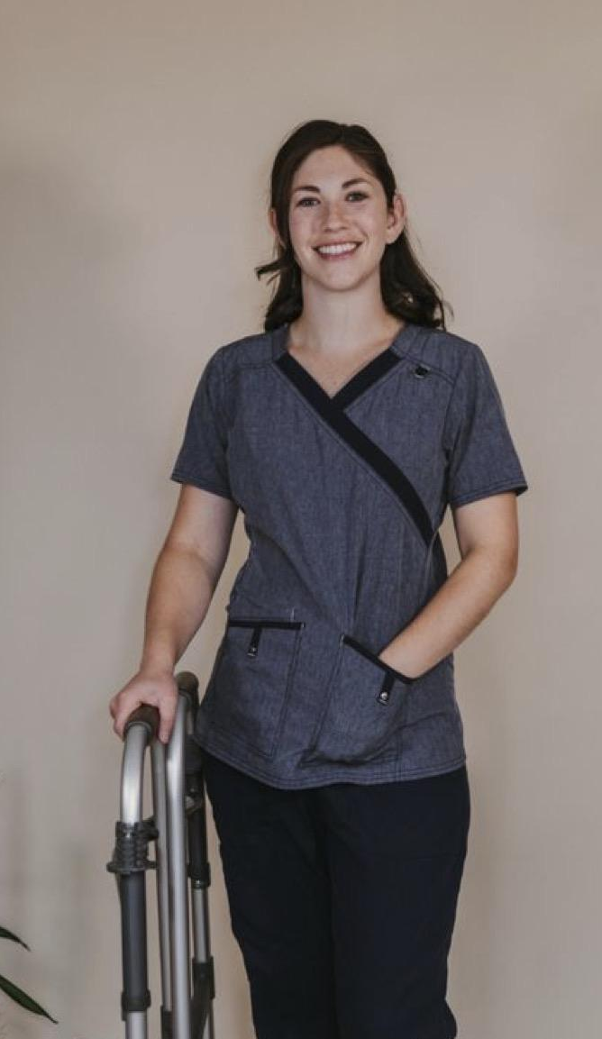




ABOUT ME
Dana Robbins, PT, DPT
Doctor of Physical Therapy
Founder and Executive Director, Home and Happy Inc.
Owner of Buffalo Health and Fitness
Duquesne University
Bachelor of Science | Biology and Health Science | 2017
Doctor of Physical Therapy | 2019
Started my career in nursing homes
Working across facilities during COVID showed me the gaps in care
Founded Home and Happy in 2022
Helping older adults in Erie and Niagara County age in place
Buffalo Health and Fitness in 2024
Cash-based setting working one on one with women and the aging population
Summit on Aging & Independence · Dr. Dana Robbins, PT, DPT
2
Notes:
Personal intro: career start in nursing homes, what COVID showed me about how older adults are cared for, and why I started Home and Happy in 2022.

Slide 3
Overview
Five questions we will work through today
1
Are we taking too much medication?
2
What about movement prescriptions?
3
Are physical therapists under-dosing?
4
How does the system fail older adults?
5
So… what should we do?
Summit on Aging & Independence · Dr. Dana Robbins, PT, DPT
3

Slide 4
01 · MEDICATION
Medication saves lives and helped push U.S. lifespan from 55 to 79
What we can’t control
Chronic disease, trauma, cancer, genetics
What we can
Decrease our risk factors through movement and diet
55
79
life expectancy
in the 1920s
life expectancy
in 2026
As a society, we have grown used to the “quick fix” of a pill.
Summit on Aging & Independence · Dr. Dana Robbins, PT, DPT
4
Notes:
There is no doubt medication saves lives. Some things we cannot control — chronic disease, traumatic events, cancer, genetics. But for metabolic syndrome, medication has become the default first line of defense.

Slide 5
01 · MEDICATION
Americans on 5+ prescriptions nearly doubled in ten years, from 6% to 11%
10 years ago
Today
48%
+13%
44%
31%
25%
increase in the daily dose of prescription medicine over the past 5 years
11%
6%
1 or more Rx
2 or more Rx
5 or more Rx
Share of U.S. adults taking prescription drugs
Summit on Aging & Independence · Dr. Dana Robbins, PT, DPT
5
Notes:
Over the last 10 years: at least 1 prescription 44% → 48%; 2 or more 25% → 31%; 5 or more 6% → 11%. Daily dose of prescription medicine up 13% in the past 5 years.

Slide 6



01 · MEDICATION
Prescribing is starting earlier and increasingly runs on autopilot
92M+
30s–40s
~6×
U.S. adults take a statin for high cholesterol (hyperlipidemia)
AHA guidelines now weigh lifetime cardiovascular risk over decades, not a 10-year window, encouraging earlier prescriptions
higher prescription rates with automated pharmacy referrals, as at Penn Medicine
Is this good or bad?
Summit on Aging & Independence · Dr. Dana Robbins, PT, DPT
6

Slide 7
01 · MEDICATION
38%
+7%
additional increase in mortality for every medication after the fifth
higher mortality among older adults who take 5 or more medications
Summit on Aging & Independence · Dr. Dana Robbins, PT, DPT
7

Slide 8

02 · MOVEMENT PRESCRIPTIONS
Doctors call lifestyle change the first line of defense, yet rarely write the script for it
“Our first line of defense is behavior change: movement and diet.”
So how often is a script actually written for a physical therapist or a dietitian?
Exercise meaningfully improves high cholesterol, high blood pressure and type 2 diabetes with minimal side effects, especially when supervised by a PT.
Summit on Aging & Independence · Dr. Dana Robbins, PT, DPT
8
Notes:
CDC and AHA asked why people don’t exercise- PTs can help with all of them!

Slide 9



02 · MOVEMENT PRESCRIPTIONS
14 systematic reviews show exercise improves all three metabolic conditions
5
3
6
reviews
reviews
reviews
Hypertension
Hyperlipidemia
Type 2 diabetes
Significant acute and long-term improvement, from light to vigorous exercise
Better total cholesterol, LDL, HDL and triglycerides across exercise types, including in menopausal women
Improved insulin tolerance and overall blood sugar regulation
Summit on Aging & Independence · Dr. Dana Robbins, PT, DPT
9
Notes:
Full citations are on the reference slides at the end. Hypertension: 5 reviews, acute and long-term, light to vigorous exercise. Lipids: 3 reviews incl. menopausal women. T2D: 6 reviews on insulin tolerance and glucose regulation.

Slide 10


02 · MOVEMENT PRESCRIPTIONS
Higher intensity and consistency produce the biggest improvements
Almost every intensity and duration of exercise improves the numbers. The strongest results come from exercise that is:
THE BONUS OF HEAVIER LOADS
Bone density
Muscle mass
Higher intensity
Two more variables that shape both the quality and the quantity of life.
Consistent over time
Summit on Aging & Independence · Dr. Dana Robbins, PT, DPT
10

Slide 11
03 · PHYSICAL THERAPY
PT’s can do what?
68%-72%
patients reported PT delivered substantial benefits.
Physical Therapists can be used for more than just pain.
Summit on Aging & Independence · Dr. Dana Robbins, PT, DPT
7

Slide 12

03 · PHYSICAL THERAPY
PTs under-load older adults by about 2 lb below what muscles need to adapt
We help older adults get comfortable with exercise
through education on managing pain and other diagnoses.
But are we doing everything we can?
Neuroplasticity and hypertrophy don’t discriminate by age. Do we?
~2 lb
average shortfall below the load needed for muscular adaptation
Summit on Aging & Independence · Dr. Dana Robbins, PT, DPT
11

Slide 13





03 · PHYSICAL THERAPY
Five pressures push therapists to under-dose
“Playing it safe”
Fear of legal action
Pushback from patient or family
High caseloads
A fragility mindset
Is our under-dosing why medication is over-prescribed, or is over-prescription the reason we under-dose?
Summit on Aging & Independence · Dr. Dana Robbins, PT, DPT
12

Slide 14
04 · THE SYSTEM
Medicare’s therapy threshold hasn’t been reviewed since 1997, and a missing comma still shapes it
The 1997 draft listed the disciplines without a comma between two of them, so PT and SLP were grouped together:
PT + SLP
OT
$2,480
$2,480
one combined Medicare threshold per year
its own threshold
Summit on Aging & Independence · Dr. Dana Robbins, PT, DPT
13
Notes:
1997 was the last time the Medicare payment threshold for therapy disciplines was reviewed. In that draft, a missing comma in the list of OT, PT and SLP grouped PT and SLP under one shared cap per year, while OT got its own.

Slide 15
04 · THE SYSTEM
Falling Medicare rates are turning clinics into “PT mills”
7–10%
Higher caseloads
Burnout
Less individualized care
drop in average Medicare PT reimbursement over 10 years
owners push volume just to make ends meet
good therapists leave quickly
improper load and exercise dosing
The result: “PT mills,” where volume replaces individualized, properly dosed care.
Summit on Aging & Independence · Dr. Dana Robbins, PT, DPT
14
Notes:
Change in reimbursement for PTAs too. This should not be happening to Medicare pts

Slide 16

04 · THE SYSTEM
Medicare home care is shrinking: fewer visits, and many referrals never arrive
10.5 → 8.4
Up to 1 in 3
average visits per home, 2017 to 2024
patients never receive home services despite a referral
Will this change within the year?
Summit on Aging & Independence · Dr. Dana Robbins, PT, DPT
15
Notes:
Therapy visits dropped the most. PT, OT and speech visits together fell from 4.9 to 3.8 per period between 2019 and 2024, a drop of about 22%. Skilled nursing went from 4.6 to 4.1. MedPAC also notes therapy visits fell almost 20% in 2020 alone. That was the first year of Medicare's new home health payment system (PDGM).

Slide 17



05 · WHY IT MATTERS
By 2030, 1 in 5 Americans will be 65 or older, and they need skilled providers
What is a skilled provider?
20%
A physical therapist is one example: someone who has...
Accredited education
of the U.S. population will be 65+ by 2030
Board certification
Accountability to a regulated board
Summit on Aging & Independence · Dr. Dana Robbins, PT, DPT
16

Slide 18
05 · WHY IT MATTERS
Medicare defines “skilled” case by case, so therapists avoid maintenance care
2013
Gap
Risk
Result
Jimmo v. Sebelius
“Skilled” left undefined
Denial after the fact
Therapists pull back
Care can continue without fast improvement, creating maintenance care in PT
Medicare decides case by case
Coverage can be denied after treatment is given, often with an audit
Maintenance care fades for the people who benefit most
Summit on Aging & Independence · Dr. Dana Robbins, PT, DPT
17
Notes:
Jimmo v. Sebelius (settled 2013) confirmed coverage can continue without significant or fast improvement, which created maintenance care in PT. It did not clarify what Medicare deems "skilled."

Slide 19
Movement is the future,
and cash is the key.
Summit on Aging & Independence · Dr. Dana Robbins, PT, DPT
19

Slide 20



06 · THE PATH FORWARD
PTs can be the buffer between the home and the hospital
We are this population’s most accessible provider, yet despite doctoral degrees and Direct Access laws, PTs are barely used within the system.
Start small
Cash or volunteer model
Build local support
Begin within our own community
Best way to expand both availability and quality of care
Community, nonprofits, organizations and local government
Social Security and Medicare depend on government funding, so change has to start locally.
Summit on Aging & Independence · Dr. Dana Robbins, PT, DPT
18

Slide 21


HOME AND HAPPY INC.
Home and Happy keeps older adults at home for as long as possible
Equipment Donation
In-Home Therapy
Insurance covers only one piece of equipment
We provide more permanent or unique equipment
Complements insurance-based care
Prevents deconditioning after discharge or between 90-day re-evaluations
Recommends equipment to improve safety and ease caregiver burden
Puts a provider in the home for faster communication and emergency support
Free for adults 65+ in Erie and Niagara County · Founded 2022
Summit on Aging & Independence · Dr. Dana Robbins, PT, DPT
20
Notes:
Founded in 2022 by Dr. Dana Robbins, PT, DPT after years working in hospital and rehab settings. Everything is free for adults 65+ in Erie and Niagara County.

Slide 22





HOME AND HAPPY INC.
Home and Happy has donated 140 pieces of equipment and given 200 therapy sessions
140
200
OUR FUTURE GOALS
Lift Chair Program
2–3 lift chairs gifted by year end
pieces of equipment donated since 2022
in-home therapy sessions since 2023
Ramp building program
Portable elevator + van transportation
Community Equipment Facebook group connects neighbors with equipment
Home remodeling
www.home-happy.org
Summit on Aging & Independence · Dr. Dana Robbins, PT, DPT
21

Slide 23
Movement Is Medicine.
Movement Is Independence.
Thank you and keep moving!
Dana Robbins, PT, DPT
Home and Happy Inc. | www.home-happy.org
Buffalo Health and Fitness | www.buffalohealthandfitness.com
@drdanadpt

Slide 24
REFERENCES
References: hypertension and hyperlipidemia
Hypertension
1. Saco-Ledo G, Valenzuela PL, Ruiz-Hurtado G, Ruilope LM, Lucía A. Exercise reduces ambulatory blood pressure in patients with hypertension: a systematic review and meta-analysis of randomized controlled trials. J Am Heart Assoc. 2020;9(24):e018487.
2. Zhou H, Wang S, Zhao C, He H. Effect of exercise on vascular function in hypertension patients: a meta-analysis of randomized controlled trials. Front Cardiovasc Med. 2022;9:1013490.
3. Chourite C, Belmouss H, Fedouache M, Challal I, Zaguiri M, Mouilly M. Effectiveness of combined exercise training for hypertension management: a systematic review and meta-analysis of randomized controlled trials. Pan Afr Med J. 2026;53:111.
4. Correia RR, Veras ASC, Tebar WR, Rufino JC, Batista VRG, Teixeira GR. Strength training for arterial hypertension treatment: a systematic review and meta-analysis of randomized clinical trials. Sci Rep. 2023;13:201.
5. Naci H, Salcher-Konrad M, Dias S, et al. How does exercise treatment compare with antihypertensive medications? A network meta-analysis of 391 randomised controlled trials. Br J Sports Med. 2019;53(14):859-869.
Hyperlipidemia
6. Chen Z, Zhou R, Liu X, Wang J, Wang L, Lv Y, Yu L. Effects of aerobic exercise on blood lipids in people with overweight or obesity: a systematic review and meta-analysis of randomized controlled trials. Life (Basel). 2025;15(2):166.
7. Nunes PRP, Castro-e-Souza P, de Oliveira AA, et al. Effect of resistance training volume on body adiposity, metabolic risk, and inflammation in postmenopausal and older females: systematic review and meta-analysis. J Sport Health Sci. 2024;13(2):145-159.
8. Bernal JVM, Sánchez-Delgado JC, Jácome-Hortúa AM, et al. Effects of physical exercise on the lipid profile of perimenopausal and postmenopausal women: a systematic review and meta-analysis. Braz J Med Biol Res. 2025;58:e14194.
Summit on Aging & Independence · Dr. Dana Robbins, PT, DPT
23

Slide 25
REFERENCES
References: type 2 diabetes
Type 2 Diabetes
9. Michielsen M, Yagiz J, Hanssens M, et al. The effect of exercise characteristics on HbA1c and other cardiovascular risk factors in adults with type 2 diabetes: a systematic review and meta-analysis. Cardiovasc Diabetol. 2026;25:30.
10. Garcia SP, Cureau FV, de Quadros Iorra F, et al. Effects of exercise training and physical activity advice on HbA1c in people with type 2 diabetes: a network meta-analysis. Diabetes Res Clin Pract. 2025;221:112027.
11. Gallardo-Gómez D, Salazar-Martínez E, Alfonso-Rosa RM, et al. Optimal dose and type of physical activity to improve glycemic control in people diagnosed with type 2 diabetes: a systematic review and meta-analysis. Diabetes Care. 2024;47(2):295-303.
12. Li H, Yang S, Wang X, et al. Optimal exercise dose for resistance training to improve HbA1c levels in overweight and obese patients with type 2 diabetes: a Bayesian network meta-analysis. Front Physiol. 2026;17:1867073.
13. Muñoz Rossi FA, Cabarcas Rua JA, Quinapanta Castro NI, et al. The force awakening in HbA1c control: high-intensity and endurance exercise in patients with type 2 diabetes mellitus. Cureus. 2024;16(11):e73401.
14. Dong C, Liu R, Huang Z, Yang Y, Sun S, Li R. Effect of exercise interventions based on family management or self-management on glycaemic control in patients with type 2 diabetes mellitus. Diabetol Metab Syndr. 2023;15:190.
Summit on Aging & Independence · Dr. Dana Robbins, PT, DPT
24

