Slide 1
New York State Office for the Aging: Expanding Services Through Technology and Innovations
Michael Gunn, Assistant Deputy Director

Slide 2
About NYSOFA
Our Mission:
“To help older New Yorkers be as independent as possible for as long as possible through advocacy, development and delivery of person-centered, consumer-oriented, and cost-effective policies, programs, and services that support and empower older adults and their families, in partnership with the network of public and private organizations that serve them.”
How We Do It:
Promoting/administering programs and services for older adults (generally 60 and older), caregivers and individuals with disabilities.
Network partnerships: 59 county-based Area Agencies on Aging (AAAs) and nearly 1,200 community organizations.
NYSOFA’s programming consists of 20 core services.

Slide 3
Home and Community Based Services
Home delivered meals (HDM)
Congregate meals
Nutrition counseling & education
Senior center programming
Health promotion and wellness
Evidence Based Interventions: CDSMEs, fall prevention, etc.
Volunteer opportunities
Respite
Legal services
Home modifications, repairs
Info & Assistance- i.e., HEAP, SNAP
NY Connects (ADRC/No Wrong Door) - LTSS I&A/R, options counseling, benefits and application assistance
Health Insurance Information, Counseling and Assistance (HIICAP)
Personal Care Level I and II (non-Medicaid)
Case management
Ancillary services such as PERS and assistive devices
Social adult day services
Transportation to needed medical appointments, community services and activities
Employment – Title V
Long Term Care Ombudsman
Some of these programs and services have specific eligibility criteria. For more information, please visit https://aging.ny.gov/ and navigate to the bottom of the page to “Programs and Services”

Slide 4
New and Expanded Initiatives

Slide 5
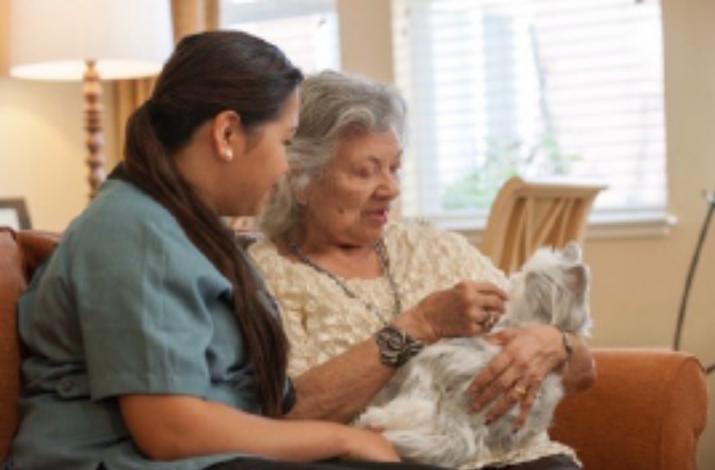
Ageless Innovation - Animatronic Pets
NYSOFA has distributed more than 40,500 animatronic pets.
NYSOFA works with AAAs to identify and screen individuals who are isolated and lonely and would benefit from receiving pet.
Plush, "lifelike" robotic pets are designed to make realistic sounds and motions, providing comfort and companionship to individuals.
Pilot study found that 75% of older adults receiving these pets reported a reduction in loneliness and 75% decrease in pain. The study was performed using the DeJong Loneliness Scale at different intervals of time.

Slide 6
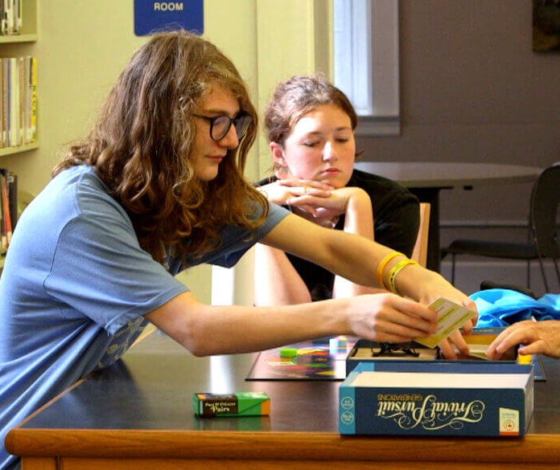
Ageless Innovation – Intergenerational Games
NYSOFA has distributed more than 35,000 games statewide.
Classic games such as Scrabble, Trivial Pursuit, and the Game of Life all reimagined and designed to meet the needs and interests of older adults.
Age-inclusive components – easy to grasp pieces, large font sizes, and intergenerational gameplay and storylines.
Encourage social engagement and intergenerational connections.

Slide 7
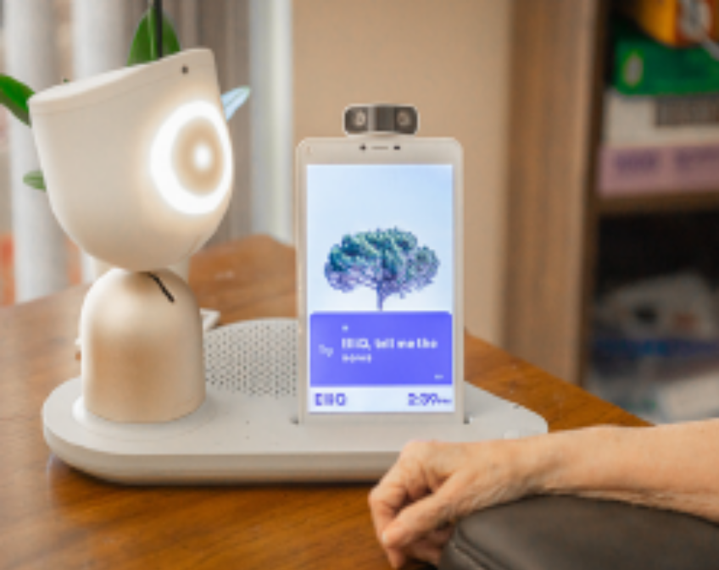
Intuition Robotics - ElliQ
NYSOFA has distributed more than 900 units statewide.
ElliQ is an AI care companion designed to foster independence and provide support through daily check-ins, assistance with wellness goals and physical activities, and more using voice commands and onscreen instructions.
Initiates conversations, suggests activities, and remembers what the user tells it. Encourages the user to set and achieve goals.
The user may use ElliQ to contact their family and other trusted individuals (e.g., case manager) if they choose.

Slide 8

Discover Live
Discover Live is available at 153 host sites (e.g., senior centers and congregate dining sites) statewide.
Interactive, immersive, virtual tours of more than 200 locations worldwide with expert tour guides.
Supports physical wellness, social connections, and brain health.

Slide 9

GetSetUp
NYSOFA’s partnership with GetSetUp has connected more than 700,000 older adults to over 6,000 free online courses and communities to help them learn new skills and interact with others who share their interests.
Classes are tailored exclusively for older adults and include aging in place, cooking, technology, fitness, nutrition, cybersecurity, health and wellness, social media, travel, and more.
Empowers older adults to bridge the digital divide, age independently, and combat loneliness.

Slide 10
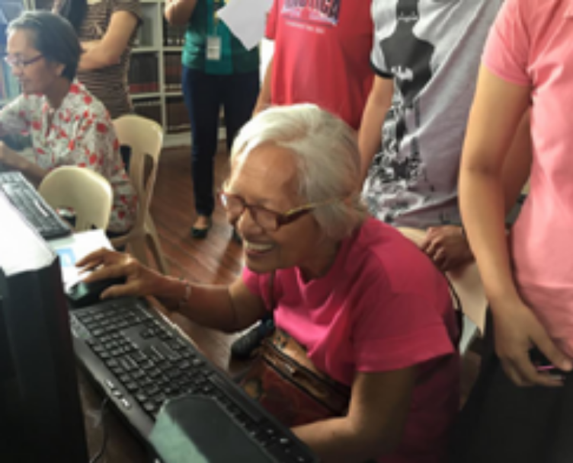
Virtual Senior Center
Online community that allows older and homebound adults to connect and engage with each other through virtual and hybrid classes.
Offers more than 400 robust programs designed for older adults, managed by social workers who provide intentional engagement. Also includes email, news, and games.
Fosters inclusive and engaging environment where older adults can connect with one another from wherever they call home.
Data has shown 84% of participants reported a decrease in loneliness; 76% reported feeling less depressed; 76% made new friends; and 67% joined programs for social connection.

Slide 11

Memory Lane TV
Immersive, interactive multi-sensory videos and experiences that create a sense of calm, connection, and wellness for individuals with Alzheimer’s and related dementias and their caregivers and providers.
Over 1500 hours of positive, plot free content personalized for each user and built to reduce agitation and depression.
Guided imagery is designed to evoke a sense of wonder and wellbeing using inspiring images, video, mood-elevating music, and more.
NYSOFA has brought this platform to various organizations serving individuals with Alzheimer’s and related dementias.

Slide 12
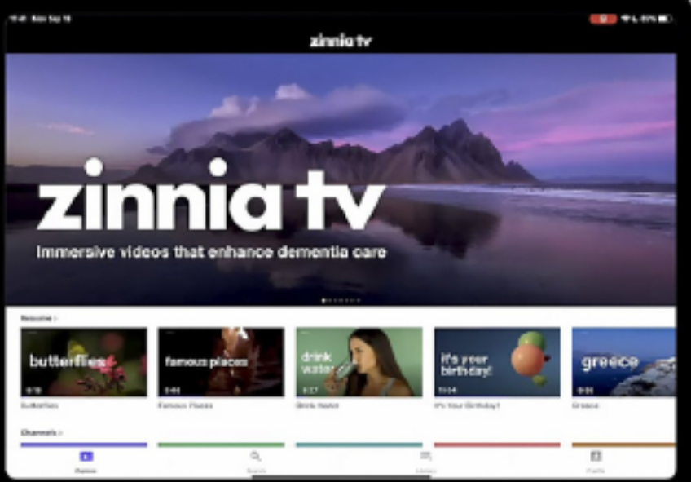
Zinnia TV
Therapeutic alternative to standard TV which can trigger confusion, stress, distress, and daytime sleeping for someone with Alzheimer’s and related dementias.
Zinnia TV allows individuals to explore a meaningful topics that will foster connections, support daily activities, soothe anxiety, and reinforce their sense of identity.
Videos are slow moving and soothing.
Promotes respite for caregivers.

Slide 13

Geri-Gadgets
Hands-on sensory kits designed to support behavioral regulation, increase participation, and reduce caregiver burden across care environments.
Common outcomes include increased engagement, reduced agitation and behavioral escalation, improved participation, and support for caregiver workflow during high-risk or unstructured moments.
NYSOFA is currently piloting the use of Geri-Gadgets in Social Adult Day Services (SADS) programs across the state.

Slide 14

ARCHANGELS’ Caregiver Intensity Index (CII)
The CII is a web-based tool designed to measure the intensity of a caregiver’s experience, assess their needs, and connect them to resources.
Engages caregivers where they are at and helps them identify and feel honored in their caregiving role.
Provides the caregiver with an intensity score that validates their caregiving experience and connects them to state and local resources.
  32% of caregivers are “in the red”
  61% of caregivers are “in the yellow”
  7% of caregivers are “in the clear”
NYSOFA has adopted the CII as the statewide caregiver assessment tool for the National Family Caregiver Support Program.

Slide 15

NY Caregiver Portal Powered by Trualta
Online evidenced based caregiver education and training portal available free of charge to all caregivers in New York State.
Teaches critical skills to reduce caregiver stress levels and increase confidence in one’s caregiving abilities.
Topics include communication changes, behavior management, care transitions, personal care, grief and loss, documents and decision making, activities and recreation, and caregiver wellness.
Connects caregivers to other New York State resources.
More than 6,100 caregivers have registered to use the Portal. 93% find the portal helpful.

Slide 16

MapHabit
Evidence-based, interactive step-b-step guides that empower individuals with disabilities, traumatic brain injuries, and Alzheimer’s and related dementias, to create healthy, sustainable habits.
Platform contains a library of more than 1,000 maps covering daily tasks that can be customized for each person.
A map is a simple, visual guide that breaks down a task into clear, manageable steps—using images, audio, video, and written instructions. Maps can be accessed on a tablet or mobile device, downloaded for offline use, or printed as a PDF when a paper version is needed.
Example, a step-by-step interactive visual guide on how to brush your teeth from start to finish.

Slide 17

Blooming Health
Digital engagement platform to improve older adults’ awareness and connection to community-based aging services.
Used to send personalized and targeted communications to older adults and caregivers through text messages, voice calls, or email.
Enables constant communication about vital information in over 80 languages:
  Weather alerts
  Deadlines for benefit applications and renewals
  Event reminders,
  Nutrition education,
  Social engagement opportunities

Slide 18

Vivo
Evidence-based strength training and exercise program to help reduce falls and associated injuries.
Online, interactive small group fitness program, with a live trainer.
Classes combine strength building with brain boosting exercises to help individuals stay sharp, independent, connected, and active from the comfort of their home.
Provides social engagement, helps to regain strength, improve mobility, and maintain quality of life.

Slide 19
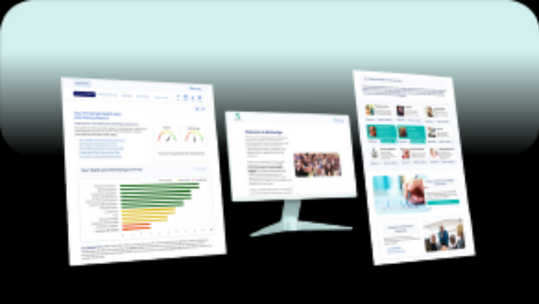
BetterAge
Free web-based platform that helps older adults identify and take small, personalized steps to improve their health, well-being, and quality of life.
Designed to support healthy aging by combining:
  Awareness: Individual completes a free health and well-being assessment that looks beyond just physical health to include social, emotional, and lifestyle factors.
  Action: Receive a personalized report with specific, easy-to-follow recommendations tailored to the individual’s needs.
  Achievement: Individual tracks progress toward their goals, feeling a sense of accomplishment as they make positive changes.
BetterAge also helps organizations gather meaningful insight on the people they serve, improve program and policy, communicate value to funders, and better support the community.

Slide 20
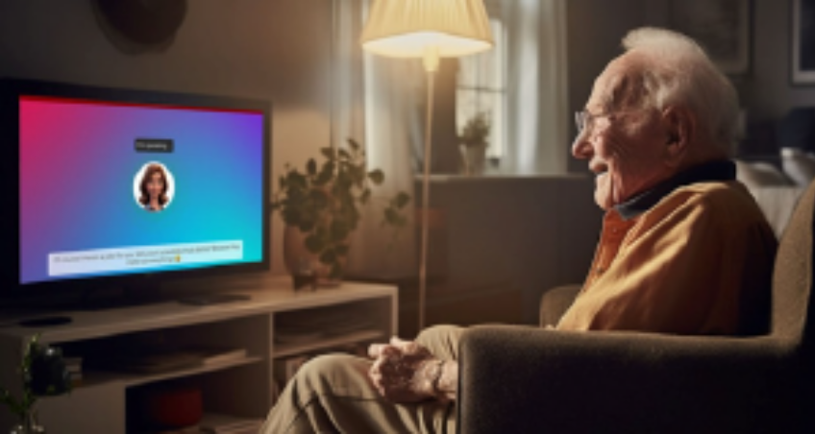
Onscreen
Transforms any TV into a caregiving hub, offering essential features like auto-answered video calls, medication reminders, wellness checks, and companionship through an AI-powered virtual companion.
Proactively engages older adults daily, based on scheduled routines set up by the caregiver and providers personalized conversations, stimulating games, memory exercises, and even virtual painting lessons.
Helps older adults maintain independence and reduces loneliness.
Caregivers gain peace of mind through real time updates and the ability to see and connect to the care receiver at any time through video calls.

Slide 21

LifeBio
Voice-powered, HIPAA compliant app that helps individuals and families record and preserve life stories, personal history, goals, interests, and care preferences, in their own voice.
How LifeBio works:
Capture What Matters - Older adults share their stories, independently or with support, through guided prompts, interviews and photo memories.
Personalize Care - Life stories become actionable insights that caregivers and clinicians can use to build trust, spark connection, and deliver more personalized support.
Strengthen Connection - Families stay engaged. Care teams understand the person behind the care plan. Older adults feel known

Slide 22

SCC MedQR
Wearable band that communicates vital information in the event of an emergency.
Laser-etched QR code transmits a brief medical summary such as allergies, medical conditions, and medication needs to first responders, police, hospitals, etc.
Improves communication between patients and medical professionals, especially if the patient is unable to communicate due to their medical condition.
Helps prevent medical errors by ensuring medical professionals have access to important information.
Provides peace of mind for patients and families knowing that critical information is always easily accessible.
May be customized to include emergency contact information.

Slide 23
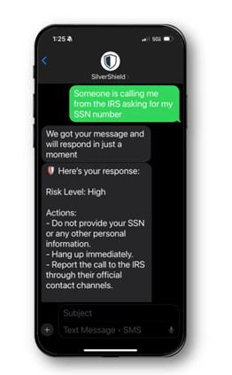
SilverShield
Personal scam assistant, making it easy for older adults to spot and stop scams.
Text, forward, or screenshot anything suspicious
Silvershield immediately reviews suspicious texts, emails, and messages, and provides easy to understand, personalized guidance on what to do to stay safe.
It also has features that allow the user to report the message to the FTC and FBI with one click and warn family and friends about the scam.

Slide 24
NYSOFA Resources and Assistance

Slide 25
Connecting With Help and Assistance
2026 NYS Innovations in Aging Guidebook
https://aging.ny.gov/innovations
AAA Directory: contact your local Area Agency on Aging directly to connect with programs and services
https://aging.ny.gov/local-offices
Health Insurance Information Counseling and Assistance Program (HIICAP): Specially trained counselors answer questions about Medicare and long-term care insurance at HIICAP counseling sites
https://aging.ny.gov/health-insurance-information-counseling-and-assistance-program-hiicap.
Video Tutorials – Federal, State and Local Benefits: Video Tutorials All in One Place: Help Older Adults in Your Community Apply for Benefits | Office for the Aging

Slide 26
Connecting with Help and Assistance (cont.)
The Long Term Care Ombudsman program (LTCOP): Regional Ombudsmen help older adults and people with disabilities who live in facility settings understand and exercise their rights.
https://aging.ny.gov/long-term-care-ombudsman-program.
Call (855) 582-6769 to reach your Ombudsman.
NY Connects: a trusted one-stop for information about long term services and supports in every community.
Personalized No Wrong Door Screening, application assistance and linkage to long term services and supports.
Online resource directory: https://www.nyconnects.ny.gov/.
Statewide telephone line: 1-800-342-9871 – connects callers with local offices for assistance.

Slide 27


