Slide 1
Overview of assistive technology and its diverse applications
Erin Brunelle, MS, OTR/L, ATP
Director of CAT
Laura Mack, COTA/L, ATP
Associate Director of CAT Client Services

Slide 2
What is assistive technology?
Under the Tech Act, assistive technology (AT) is defined as:
  "Any item, piece of equipment, or product system, whether acquired commercially or off the shelf, modified or customized, that increases, maintains or improves functional capabilities of individuals with disabilities."
AT services are defined as:
  "Any service that directly assists an individual with a disability in the selection, acquisition, or use of an assistive technology device.”
AT is a broad field that encompasses of range of low to high tech options

Slide 3
Categories of Assistive Technology
Daily Living
Communication
Vision
Hearing
Learning, Cognition and Development
Mobility, Seating and Positioning
Environmental Adaptations
Vehicle Mods and Transportation
Computers and Related Peripherals
Recreation, Sports and Leisure

Slide 4
Trends in Digital Technology
Built-in accessibility features across mainstream devices like computers and phones
Voice assistants that enable people to ask questions and complete tasks hands-free
Change from one-time purchases to subscription pricing models
Increase in mainstream smart home products
Increase in internet-connected devices
Legislative changes to digital accessibility from the Title II ADA Digital Accessibility Rule
Strong marketing that may require research to determine the reality of the item
Artificial intelligence is embedded in much of our technology systems

Slide 5
Factors towards a Good “Fit”
Dynamic interaction between factors of the:
  Person: personality, preferences, skills, culture, knowledge, abilities
  Environment: built and natural environments and objects, and their attributes such as noise and light
  Technology or “Tool”: characteristics and abilities of the technology itself and how it interacts with the person and the environment
Models of assistive technology highlight that these factors are unique to the person, their physical and social environments, the tasks they need to complete, the assistive technology system, and other technology it must interact with

Slide 6
Person and Environment Factors
What are the person’s goals and needs?
What are the person's strengths, abilities, and preferences?
What task(s) must be completed?
What are specific demands of the task?
What environment(s) is the technology being applied in?
What are the factors of the environment?
What barriers are currently preventing success?
Are there other people in the environment who will use the system?

Slide 7
Criteria for Evaluating AT
Developed with consumers through data gathered by CAT and WNYIL in the mid-90’s:
  Effectiveness
  Affordability
  Reliability
  Portability
  Durability
  Securability
  Physical security/safety
  Learnability
  Physical comfort/acceptance
  Ease of maintenance/repairability
  Operability

Slide 8
Applications of Assistive Technology

Slide 9
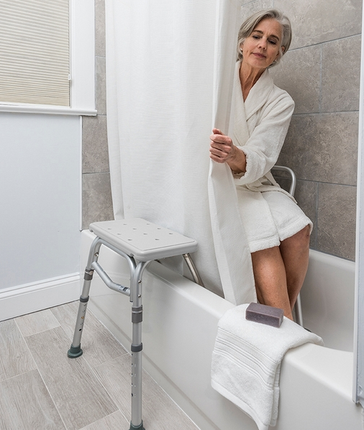
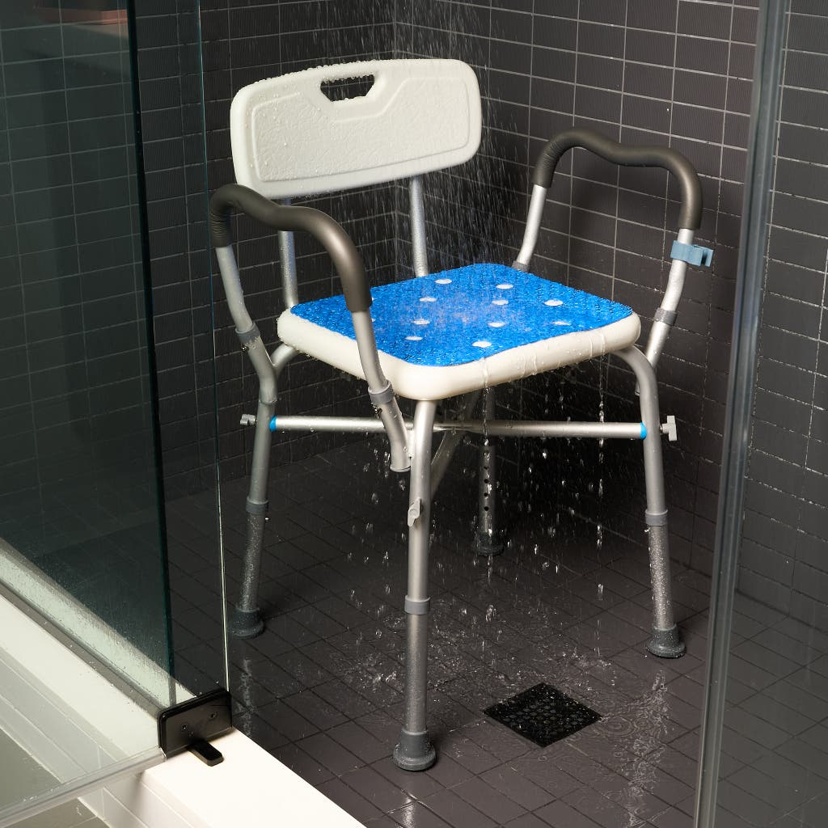
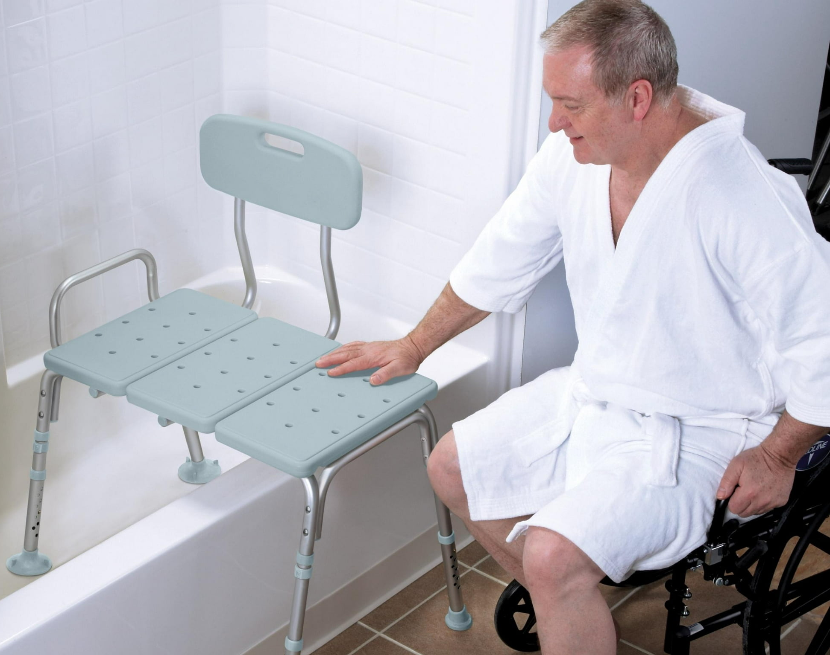
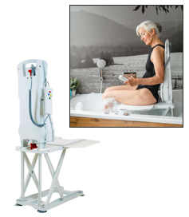
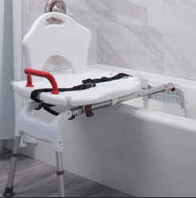
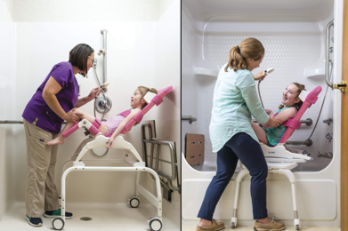
Bathing
  Range of physical supports for tubs and showers for personal and environmental characteristics
  Much more than just a “shower chair”
Shower Chair with Backrest and Handles
Drive Tub Bench
Tub Bench with Curtain Guard
Drive Sliding Transfer Bench
Rifton Wave Bathing System, shower base (left), tub transfer base (right)
Drive Bath Lift

Slide 10
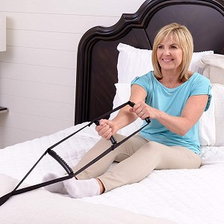
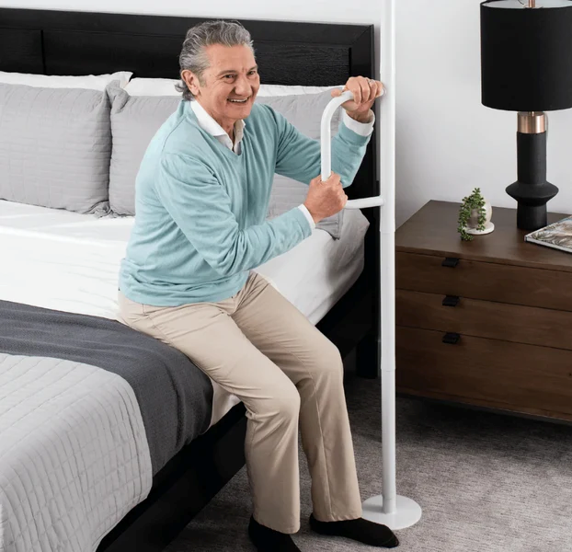
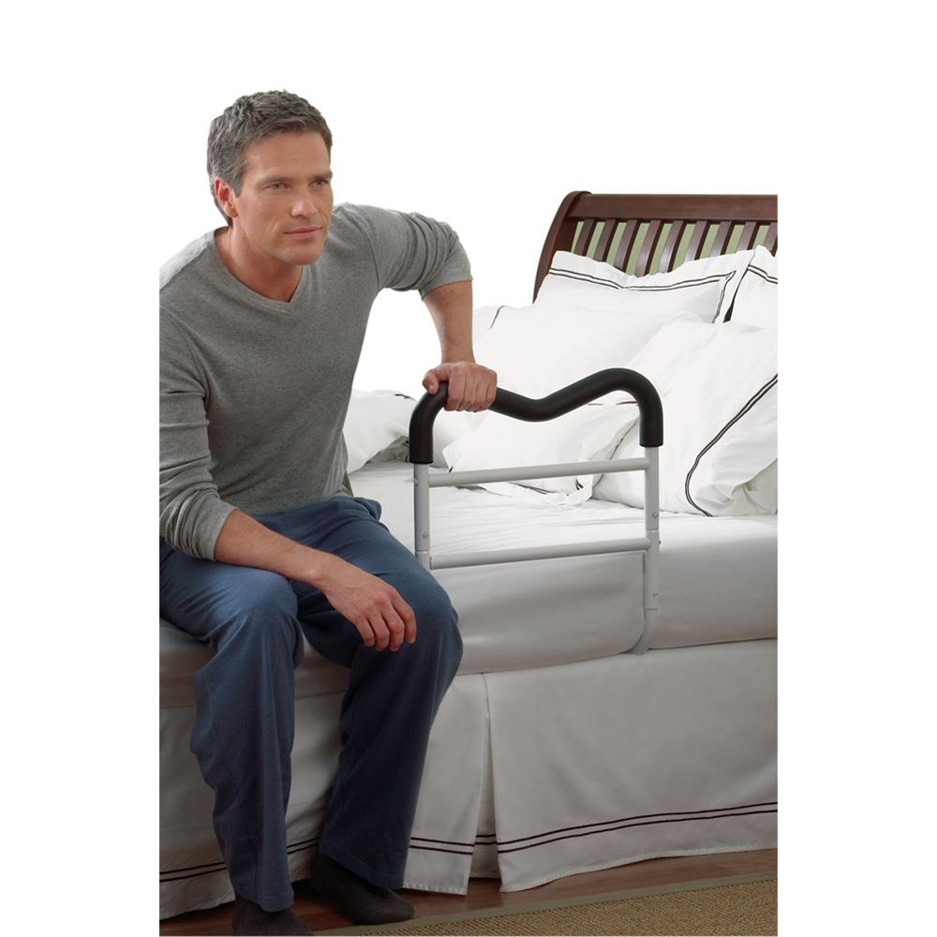
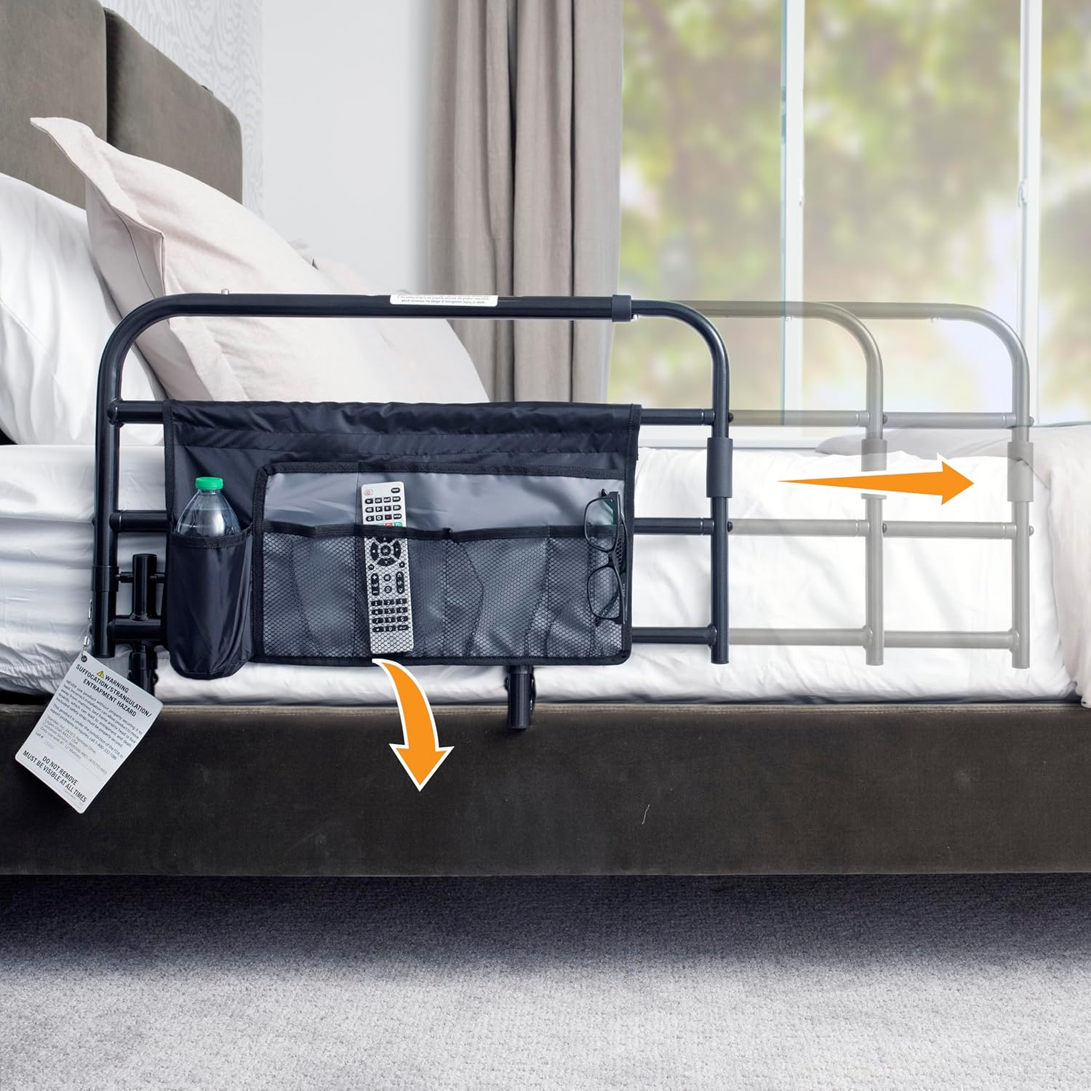
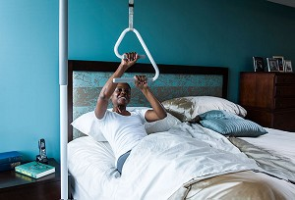
Bed Supports
  Bed cane
  Bed rails
  Transfer poles
  Trapeze
  Ladder
  Risers
Bed Ladder
Stander Wonder Pole Lite
Drive Medical M-Rail
Bed Trapeze with Floor Stand
Stander Wonder Pivot Bed Safety Rail

Slide 11
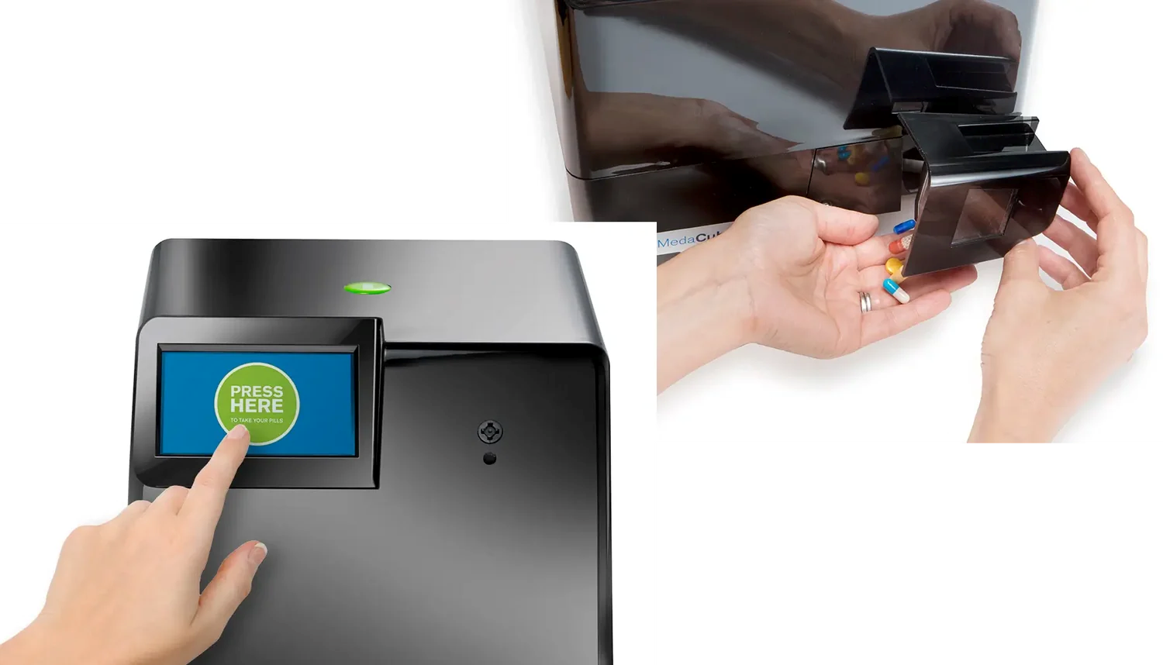
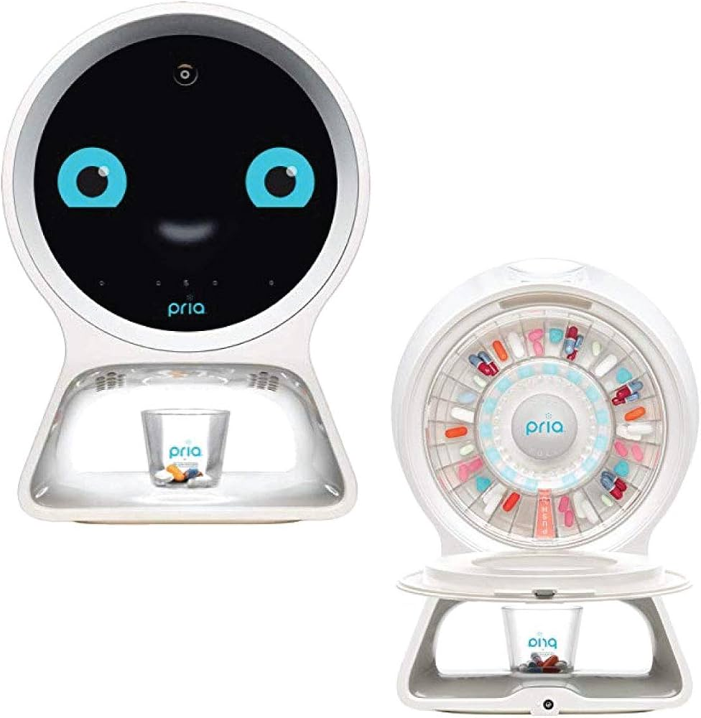
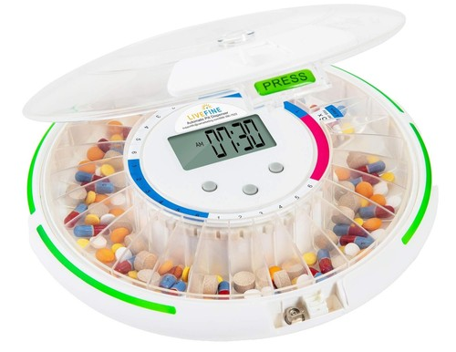
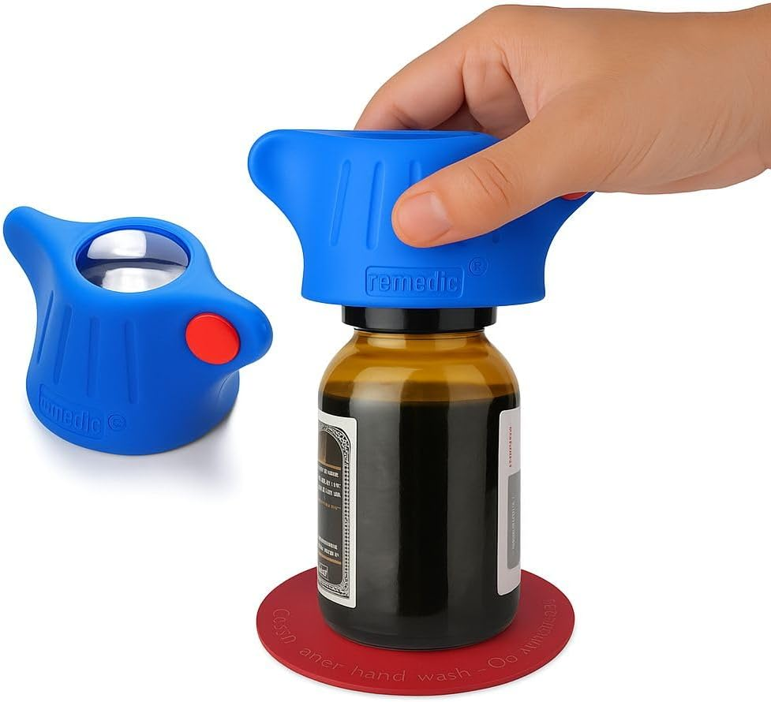
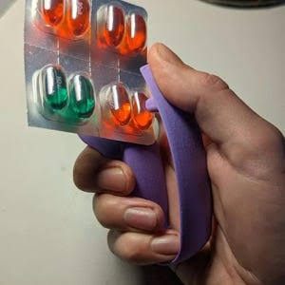
Medication Management
  Physical supports include a range of openers and organizers
  Cognitive supports include a range of AT that uses reminders, alarms, and automated dispensing systems
MedaCube Automatic Pill Dispenser
Pria Medication Dispenser
Locking Pill Organizer with Timer
3D Printed Blister Pack Opener
Remedic Medicine Bottle Opener

Slide 12
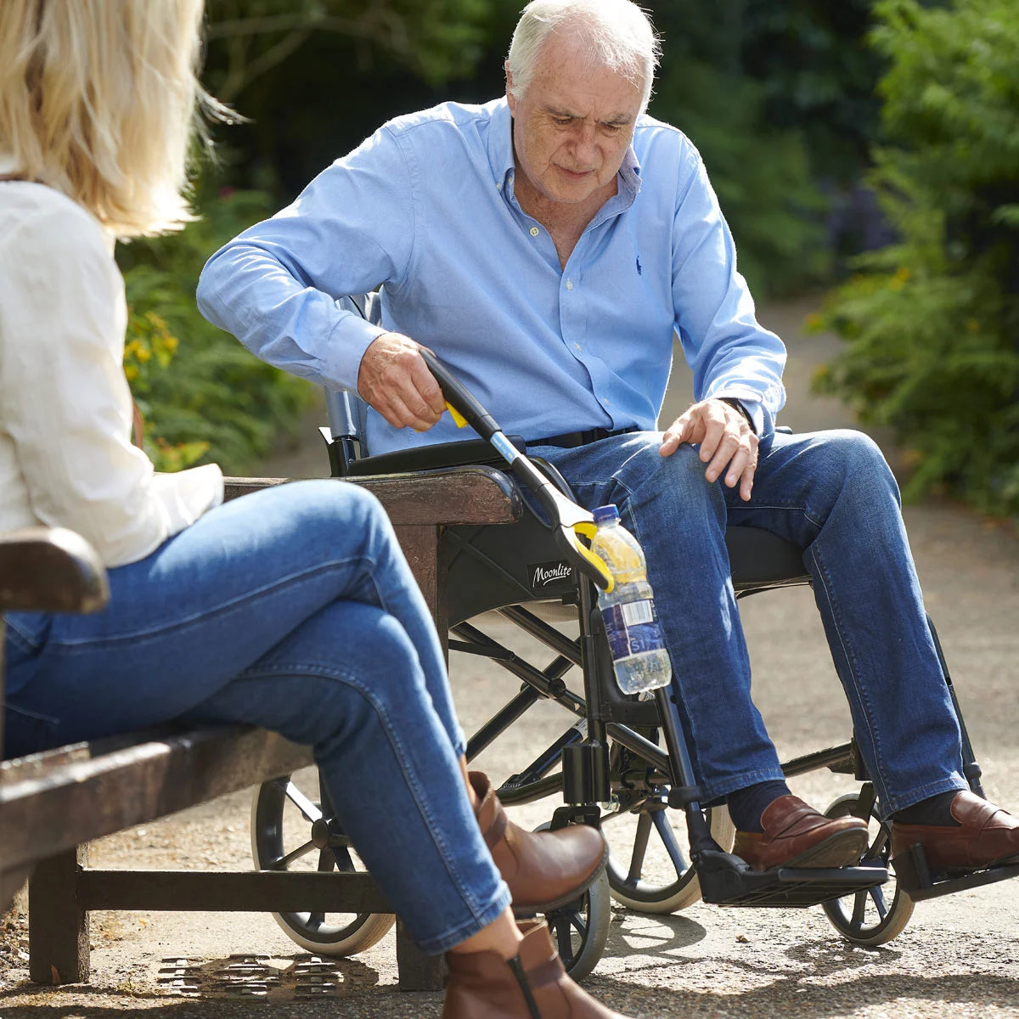
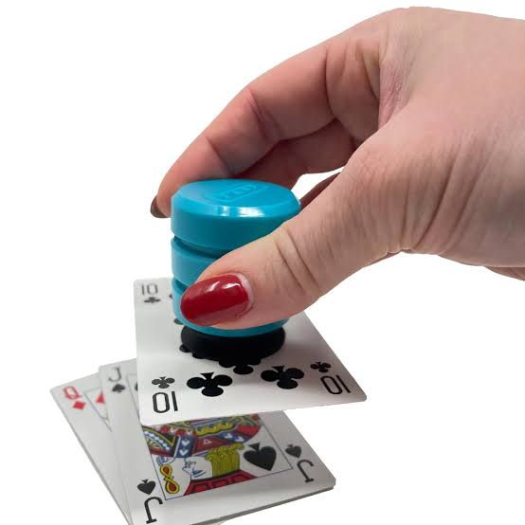
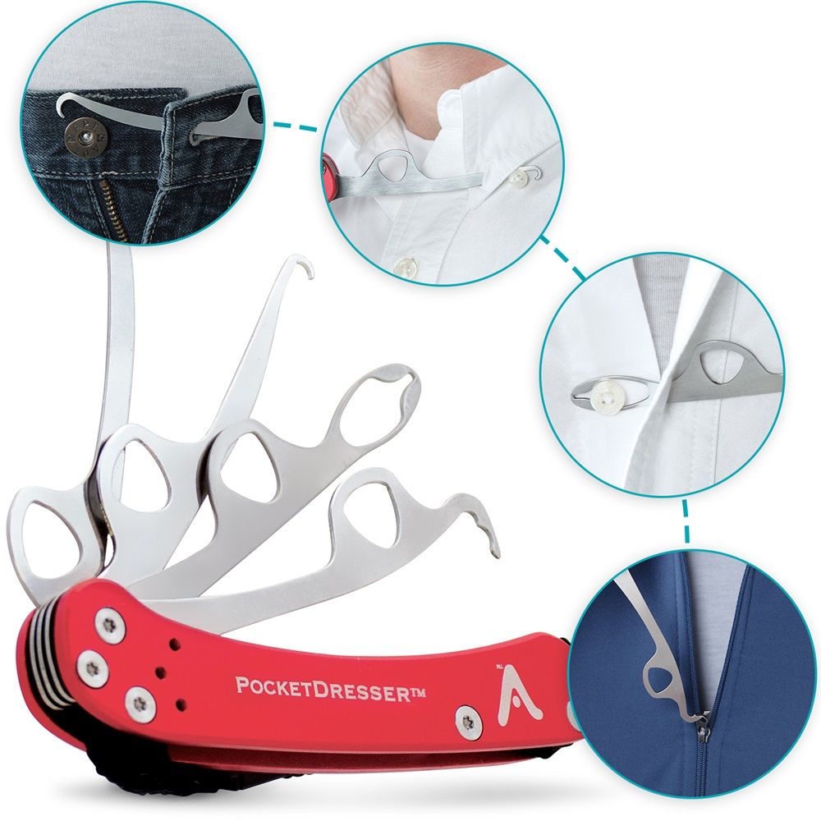
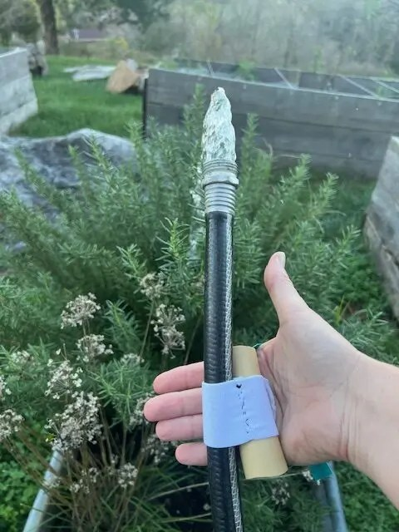
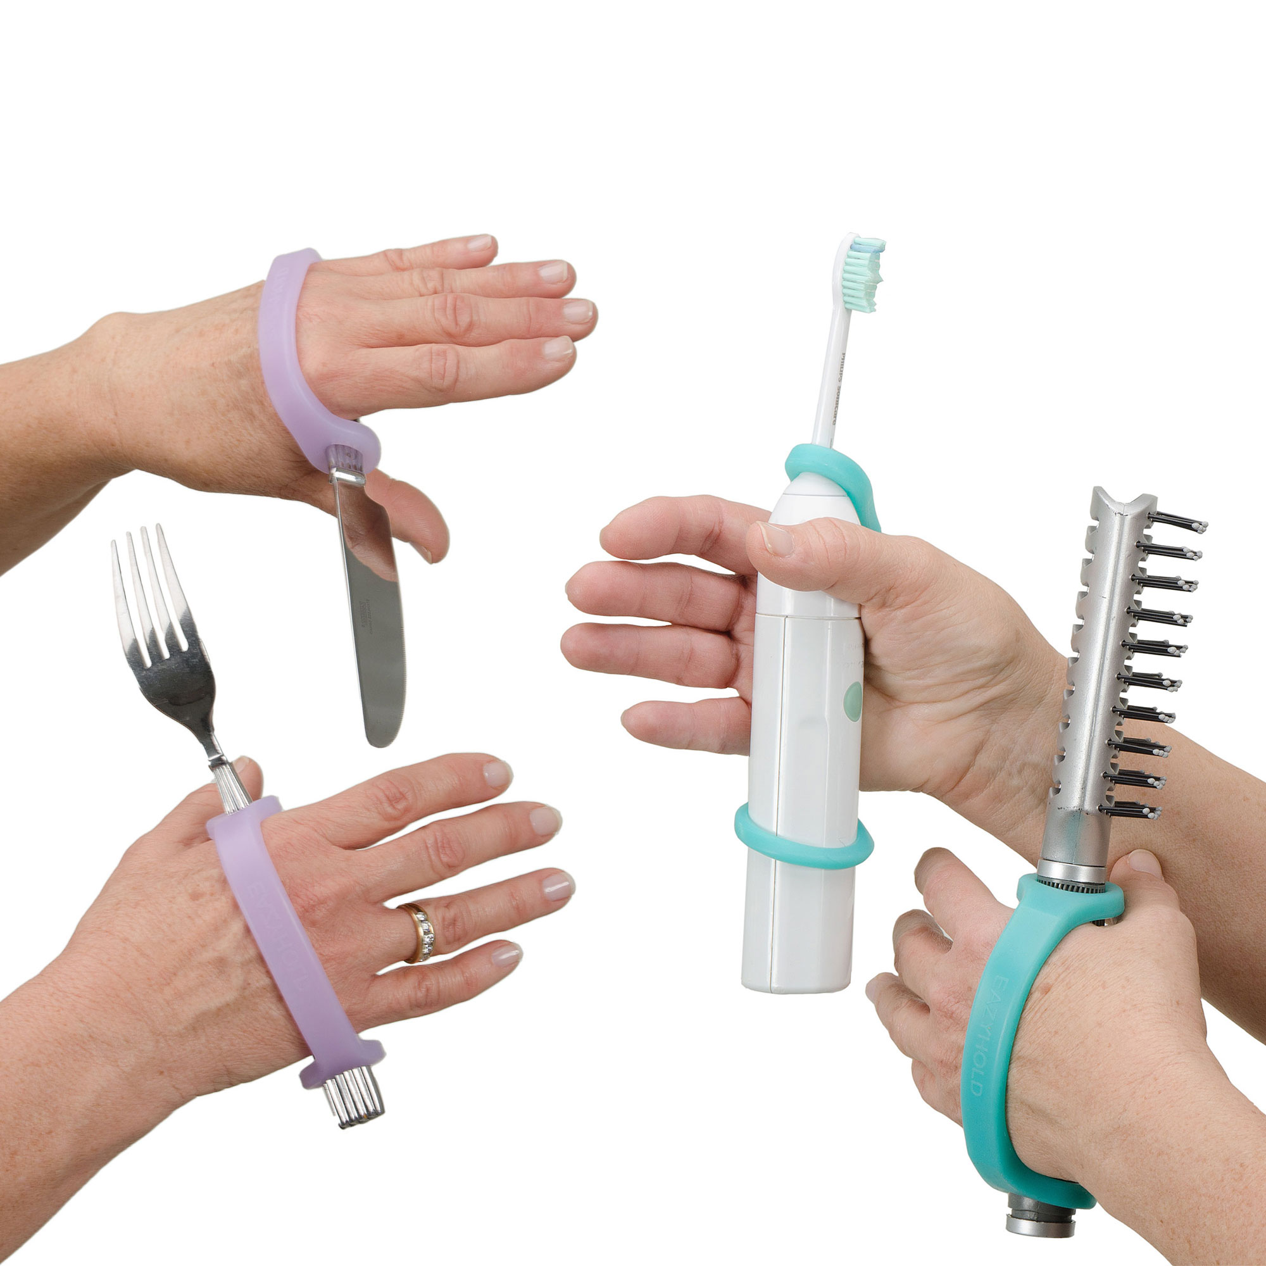
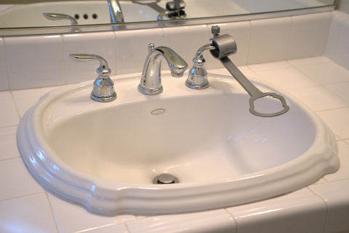
Grasp and Reach Supports
  Range of tools and modifications for grasping, reaching, holding, and manipulating objects
Short Reacher
P’kup Card Tool
Pocket Dresser Multi-Tool
DIY Universal Cuff for Hose
Faucet Handle Extender
EaZyHold Silicone Universal Cuffs

Slide 13
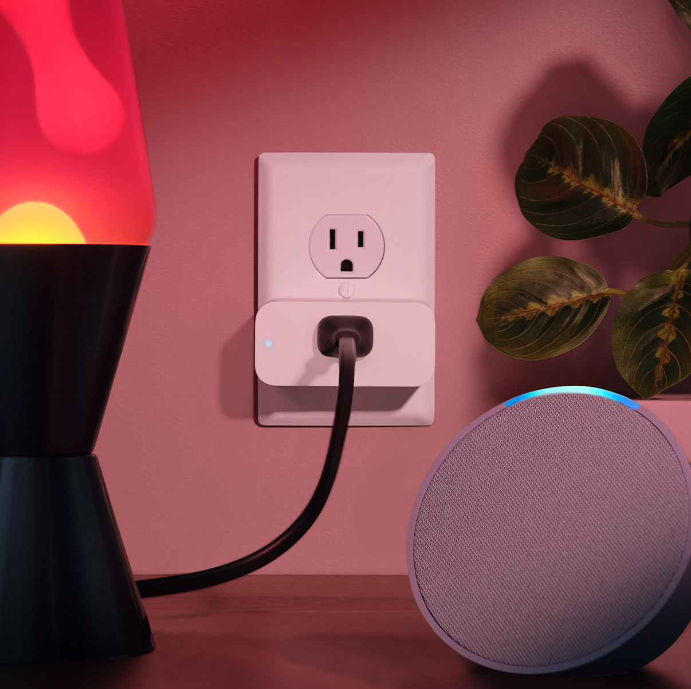
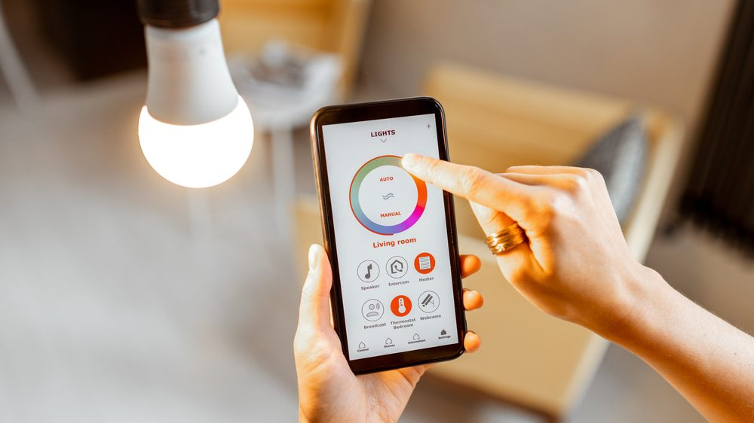
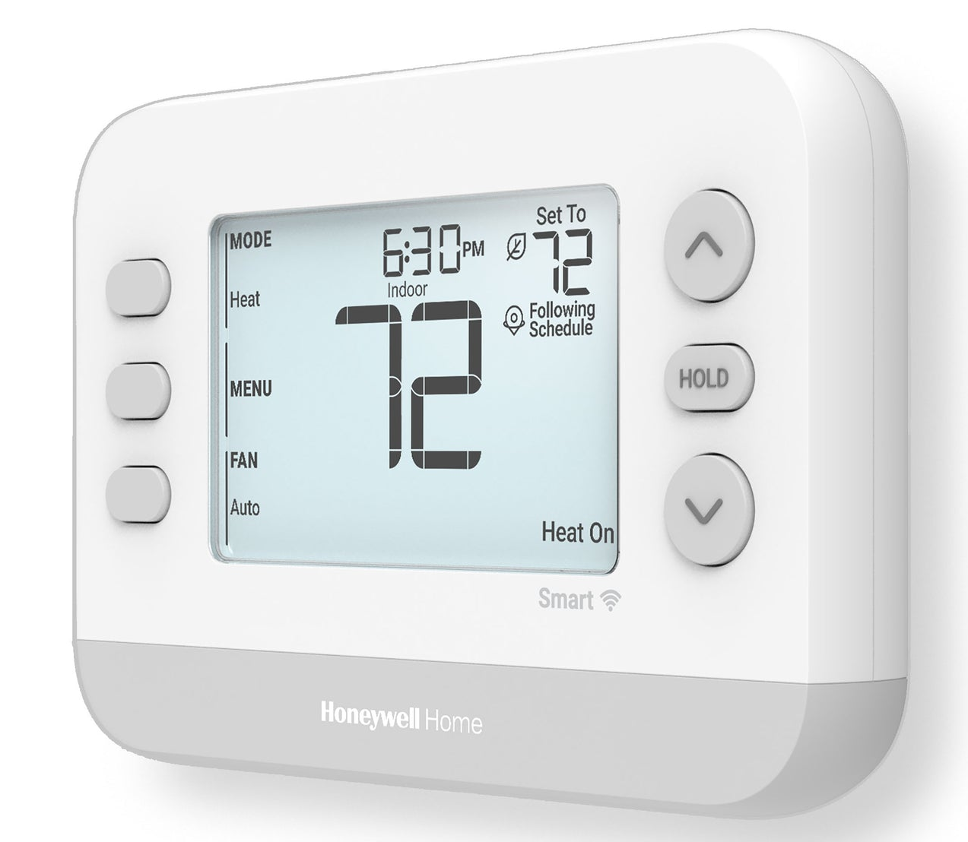
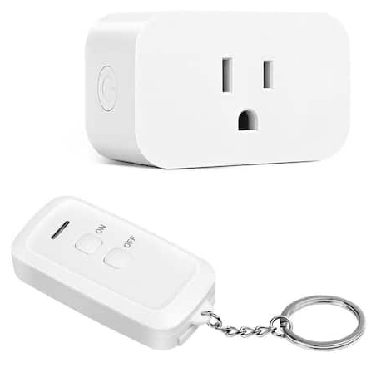
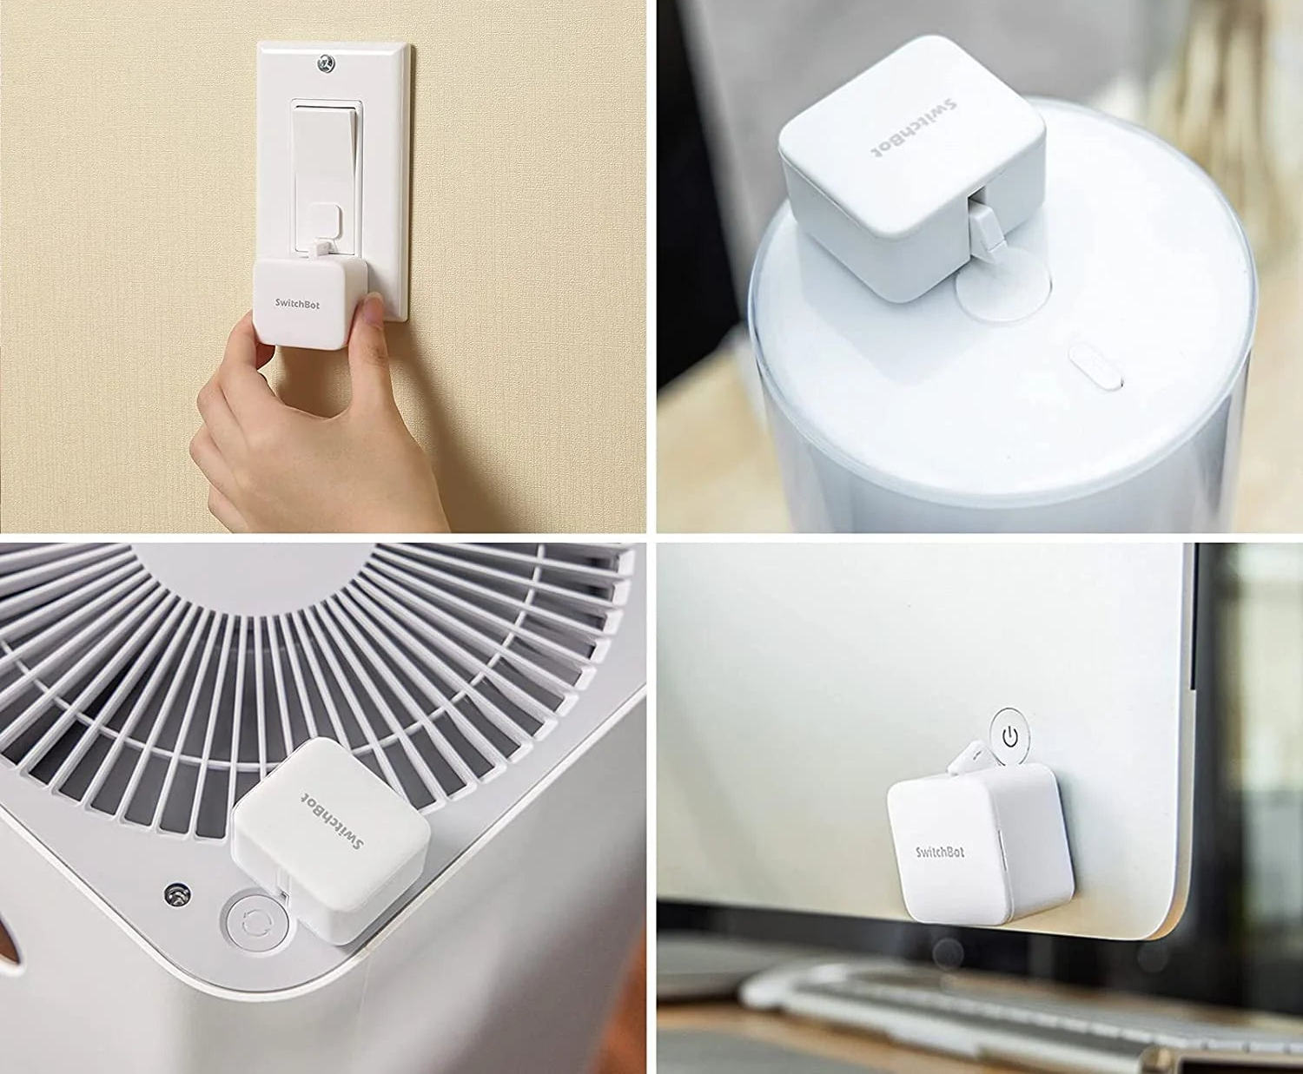
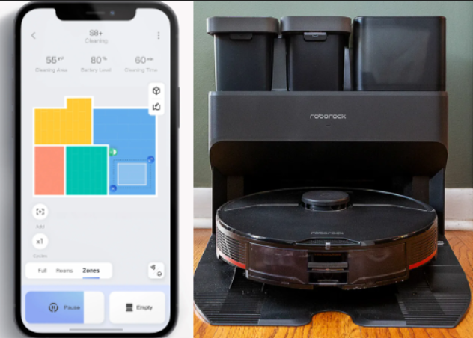
Home Automation
  Internet connected devices or “smart home”
  Infrared and radio control units do not require internet or voice assistant
  Factors to consider include setup and maintenance of a smart home system and tasks being completed
Honeywell Smart Thermostat
Remote Control Plug
Alexa Smart Plug
Smart Lightbulb
Switchbot Bot on light switch and buttons
Roborock Self-Emptying Vacuum and Mop

Slide 14
Facilitating long-term use & limiting abandonment
Selection and acquisition
  When users are involved in selection, devices are more likely to be retained
  Trialing of a device can assist in selection
Device performance
  Considering how device meets user needs, its reliability, comfort, ease of use, safety, and durability
  Selecting devices that are expected to be supported long-term, by established manufacturers and vendors
Training is often necessary for users and stakeholders and may need to be ongoing
Considering factors of the person-environment-technology fit throughout the process

Slide 15
Western New York TRAID Center
The University at Buffalo Center for Assistive Technology provides the NYS Technology-Related Assistance for Individuals with Disabilities (TRAID) Program in WNY
Counties served: Erie, Niagara, Orleans, Genesee, Wyoming
Free device loans and demonstrations for individuals with disabilities, their family members, professionals, and students
An extensive inventory of AT devices is available, supporting all ages
NYS counties are supported by TRAID Programs and other states’ programs are listed through the National Assistive Technology Act Technical Assistance and Training (AT3) Center

Slide 16
Contact CAT
210 John Glenn Drive, Suite 14
Buffalo, NY 14228
(716) 836-1168
cat-traid@buffalo.edu
All services, including loan returns, are by appointment only

